Slide 1
MLA Formatting
By:
Kymberly Briska
Ternesha Noelzinord
Idayat Idris

Slide 2
Basic MLA Formatting
Normally when writing a paper you would use the normal 8.5” x 11” paper size
Double Space the entire paper
Use a 12 pt font (normally Times New Roman
Set margins to 1 inch on all sides
Indent every paragraph
Header that includes page number and your last name
Work Cited Page (not a bibliography or reference page)

Slide 3
Basic’s Con’t
The basic formatting guidelines are something you should always follow unless otherwise specified by your teacher
An MLA formatted paper does not include a cover page because everything that would be involved on a cover page is on the first page of your paper.

Slide 4
The Margins
It is important you have the correct margins in your paper. Normally those are set for you automatically when you open a word document because it was made to fit an 8.5” x 11” paper.
Once you finish typing on your first page you might notice the margin at the bottom to be a bit bigger than all the others.

Slide 5
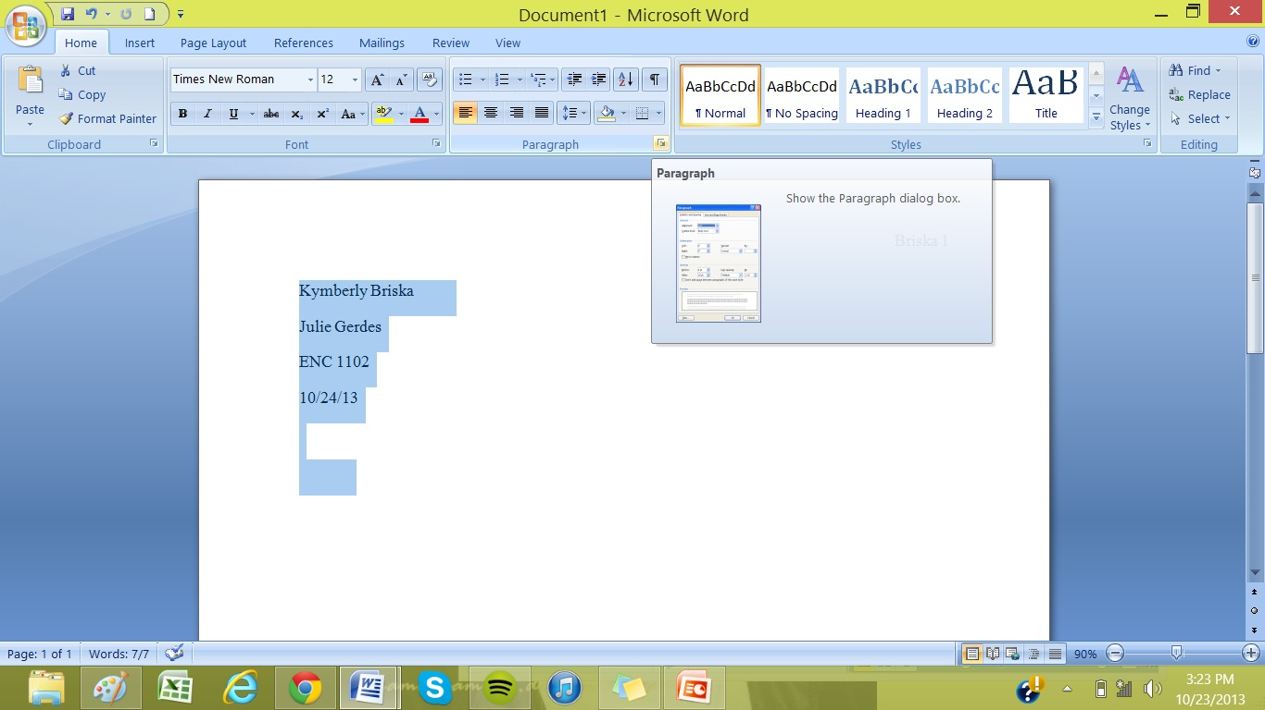
Margins Con’t
Highlight the text you have thus far
There is a setting in the “Paragraph” formatting section that can fix this problem and it’s relatively simple!
CLICK THIS

Slide 6
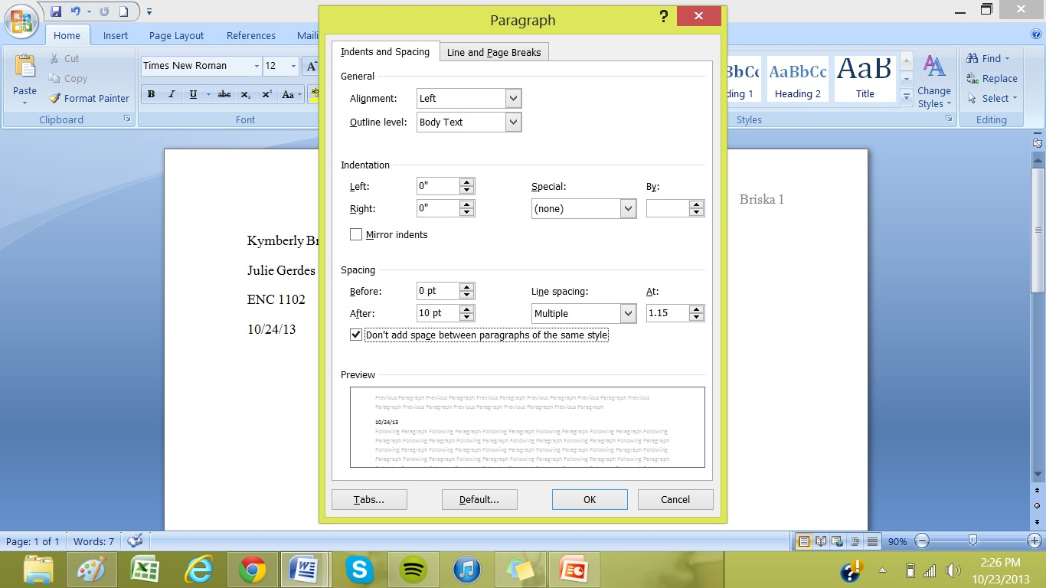
Margins Con’t
Once you click that this box will pop up on your screen
You will want to check the “don’t add spaces between paragraphs of the same style button”
This will prevent a triple space in between paragraphs

Slide 7
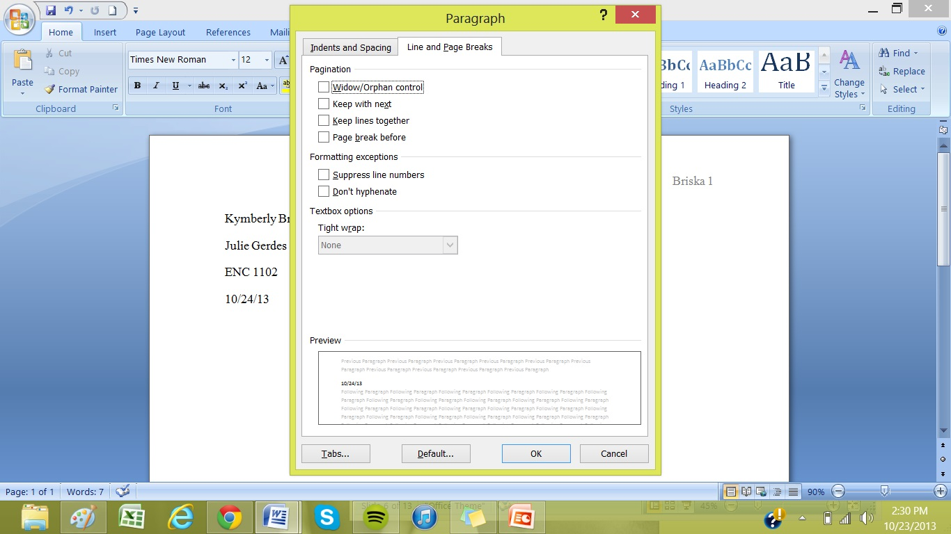
M A R G I N S C O N T
You will next want to click the “Line and Breaks” tab and unclick the “Widow/Orphan Control” button because this will prevent your margin at the bottom of your paper to be too big. Then just press “OK”.

Slide 8
Proper Header
On top of your paper you will want to include a header that includes YOUR last name and the page number.
The easiest way to do this is to go to the top of Microsoft Word and click the “Insert” tab

Slide 9
Header Con’t
You will then click Page Number

Slide 10
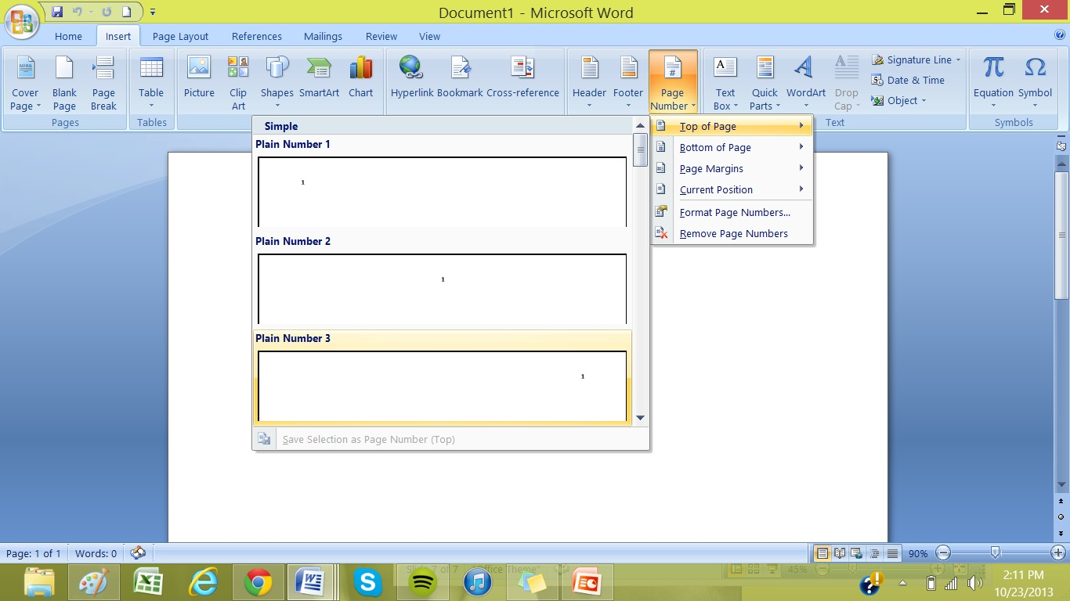
Header Con’t
Once you click “Page number” this will pop up and you will want to choose the option to put it in the top right corner of your page.

Slide 11
Header Con’t
Once you insert the page number you can now type in your last name next to the page number and now this header will appear on every page of your paper.
Once you type your last name you will want to click CTRL+A to select all the text in the header and change your font to Times New Roman at 12 pt.
It is VERY important you have the right font and size in every part of your paper!! ☺

Slide 13
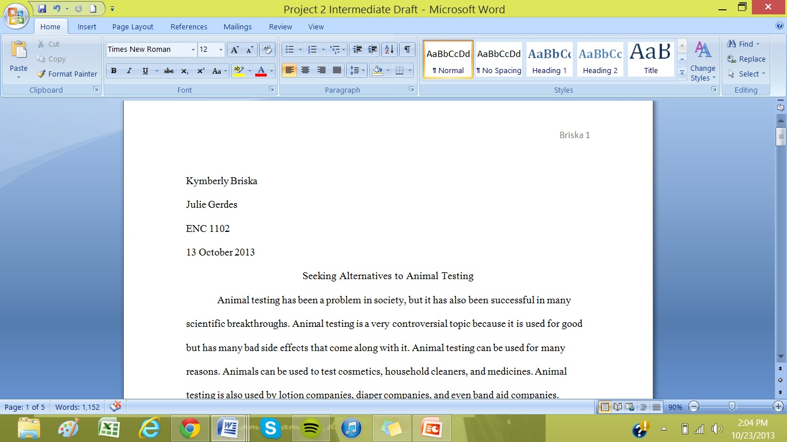
Before Beginning Your Paper
At the top left side of your paper you should ALWAYS INCLUDE:
Your Name
Instructors name
The course Name
The due date of the paper( not the day you wrote it)

Slide 14
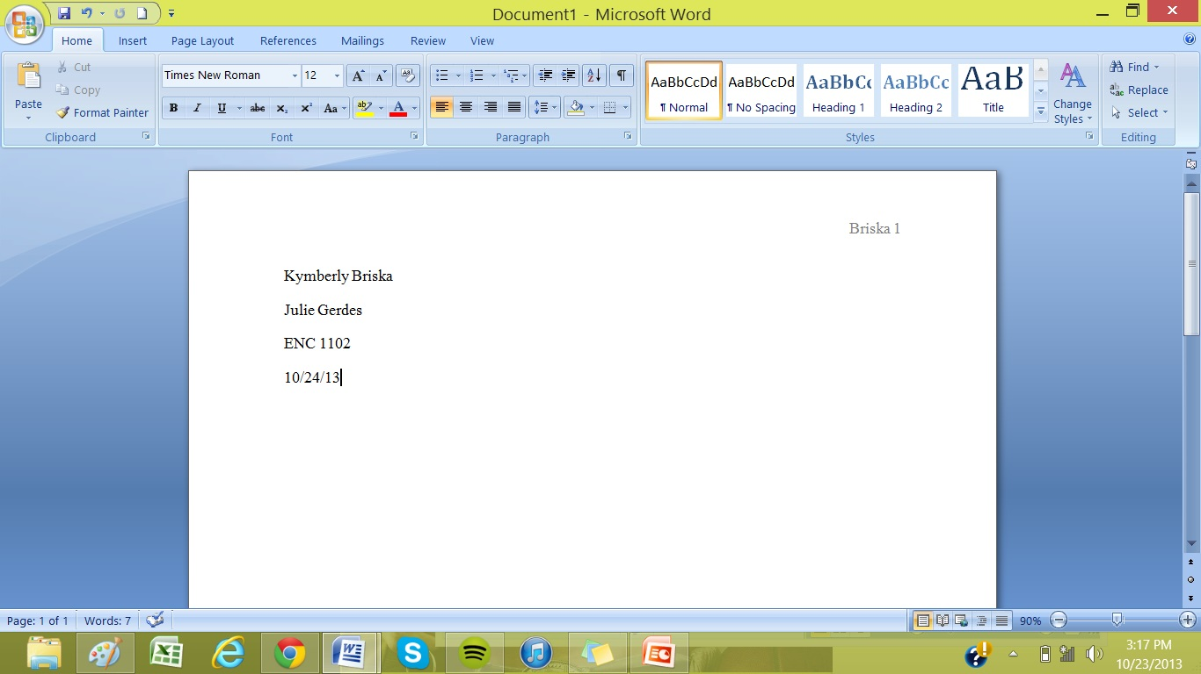
D O U B L E
Once you have:
Your name, your instructors name, class title, and date this would be a good time to double space your paper. So that you know its correctly formatted as you’re writing.
S
P
A
C
I
N
G

Slide 15
Double Spacing Con’t
Highlight the text you have thus far
You will again click on the “Paragraph” button in order to access the formatting Screen

Slide 16
Double Spacing Con’t

Slide 17
Writing Your Paper
Once you have a proper heading everything is formatted correctly you can now begin writing your paper! ☺

Slide 18
Works Cited
Make sure that in your work cited page that the citations are in ALPHABETICAL ORDER
Second line and any after in each citation MUST be indented in order to distinguish between two different citations

Slide 19
THE END! ☺

Slide 20
Works Cited
"Welcome to the Purdue OWL." Purdue OWL: MLA Formatting and Style Guide. Purdue Owl, n.d. Web. 24 Oct. 2013. <https://owl.english.purdue.edu/owl/r esource/747/01/>

