Slide 1
Visual Modes of Communication adapted from presentation by Instructor Sarah Beth Hopton for ENC4218: Visual Rhetoric

Slide 2
Learning to see
First of all understand designing is about learning to see.
Think about how a mother looks at her child,
or your beloved looks at you.
Seeing is not simply a physiological process; it’s affected by who we are, where we live, and how we’ve been raised.
Though it may be easier to process what we see because of how our brains work, composing & learning to analyze visual texts is not any easier than doing so for written texts.

Slide 3
Purpose, Audience, Context
Visible purposes: drawings/photos often carry more emotion than text but audiences respond to visuals differently. Visuals include more than photos/art: graphics, charts, sculpture. Printed docs have a formal feel. In other words, medium supports purpose.
Visible audiences: we can’t always predict the associations other have so it’s crucial to ask. Think of audiences as people with beliefs, values, and opinions you want to engage, not necessarily alienate.
Visible contexts: biggest problem is poorly designed for context. Study the contexts where your visuals will appear. Make design decisions based on context e.g. color, weight, type, size, interaction etc.

Slide 4
Theses for visuals, really?
Yes, remember that a thesis brings together your initial sense of purpose with your knowledge about your audience and the context in which your audience will encounter your visual text.
By doing this, you sharpen your sense of what it is you hope to achieve with your analysis and so you set yourself up to make crisper decisions about the visual strategies you will refer to.

Slide 5
Logos, Ethos, Pathos for Design
Our arguments for logos, ethos, pathos are only good for 21st century Americans > context matters
Logos, ethos, pathos can be found in stained glass windows, weather charts, biology texts from the 19th century, tattoos & piercings, the cover of a Koran.
Visual design is about activating values: compassion, diversity, simplicity, self-awareness. Learning to see and read visual texts is critical to self-actualization.

Slide 6
Ethos in visual design
You see what you focus on; so pay attention to your focus
How have elements been arranged?
What in the photo/chart/visual asks you to think about the character of the photographer?
See more than people & objects but the photographer’s decisions. Why does the photographer want you to see the scene arranged in a particular way?

Slide 7
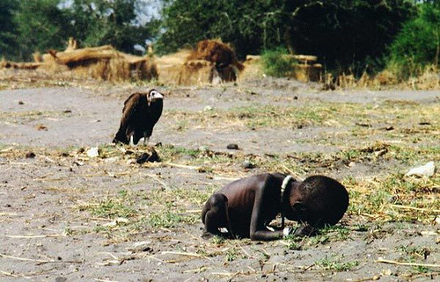
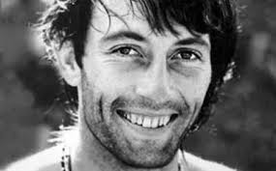
Kevin Carter

Slide 8
Pathos in design
There is obvious pathos in ads that seek to provoke a purchase so we can mimic the pathos of the ad.
But, less obvious pathos includes only showing some of an object (which provokes curiosity & sometimes fear) or context e.g. a Christmas card
When analyzing images rhetorically, name the emotions
Pathos is also created through color: hue, saturation, brightness, contrast
Pathos is also created through fonts: comic sans > happy; Times > serious; Cutty Sark > 17th century

Slide 9
Logos in design
Logos is about arrangement, so in visual design it’s about elements on a page
C.R.A.P. : contrast, repetition, alignment, proximity
You want a clear visual path
Arrangement doesn’t just apply to the overall composition, but to individual elements of type, color, and object

Slide 10
Analyzing Visual Arguments
Analogies
Symbols
Accumulation
Compares two objects, events, or processes so the more familiar explains the less familiar. Example: the British Ad for War pg. 268.
Contain emotion and understanding condensed into a drawing or object. Example: the Statue of Liberty.
To pile up objects that are similar to the same. Example: the artwork of Chris Jordan
www.chrisjordan.com

Slide 11
Project 1 Thesis
For Project 1, think about your stakeholder specifically. What is the purpose for creating and distributing the images the organization presents?
Looking at a) just the visuals and b) just the written statement/mission, what is the organization’s argument? Do a and b match up? Does A support B? Contradict B? How and why?

Slide 12
Project 1 Thesis Options
Emerging
Both images support/do not support Stakeholder X’s mission to do/be y.
The colors and symbols in Stakeholder X’s images support their mission to do/be y.

Slide 13
Project 1 Thesis Options
Developing
The use of neutral tones and passive voice in Stakeholder X’s visual representation implies a relaxed and sustained approach to services, which contradicts the organization’s stated goal to “get to work fast.”

Slide 14
Project 1 Thesis Options
Mastering
While visual elements a, b, and c in image d support Stakeholder X’s stated view on y issue for an audience of z, visual elements e, f, and g of image h present the Stakeholder’s interests as the opposite of their stated view.
Example: Although Dadg Auto emphasizes its investment in clean energy by using a leaf symbol, idyllic white clouds, and minimalist composure in its electronic ad campaign, this concern for the environment is called into question by the company’s print ads in Rough Life Magazine, which demonstrate an apparent focus on more industrial and economic priorities by featuring steel and fire visual elements.

Slide 15
In-Class Activity
Find a partner and tell them about the stakeholder you’ve chosen. What is the stated message? If you two were the designer of a marketing campaign, how might you present that message?

