Slide 1
The Poster Session

Slide 2
First...
Format: for now, ptt is best (although you could certainly do it in InDesign or another software)
Size: 4’ tall x 6’ wide
OR 36” x 47”
OR 48” x 56”

Slide 3
Setting up your slide
Open a blank PowerPoint slide
Go to File: Page Setup.
  Create a custom size, and input 56 inches wide, 42 inches high.
  Make sure that the slide is set to landscape.
Go to View: Slide Master. There, you can change the default fonts, colors, and background. When done, go to View: Normal.
Add text boxes and graphics.

Slide 4
Things to Remember
Images for print should be at 300 dpi resolution at full size (72 for screen, 300 for print)
Use the zoom feature to see how your poster will print at 100% and to check for pixelation. Go to “fit” to see entire poster.
Font: 100-pt font is about one inch high.
  Title: 70-120 pts.
  Subtitle (e.g. student names): 48-80 pts.
  Section headers (e.g. background, methods): About 50% larger than body text, 36-72 pts.
  Body text: serif, 24-48 pts, consistent throughout
Don’t use ALL CAPS

Slide 5
Messing with objects
To format a text box, right-click inside it and select Format Text Box. For background color, click the Colors and Lines tab.
To create a border around a text-box, right-click inside it, then select Format Text Box. Select options in the Lines area to choose your preferred line color, type of dash, style, and weight. (The default weight of .75 points is usually much too small for posters. Try 3-6 points for a border.)
Grouping objects together: To facilitate rearrangement of objects on your poster, it may be advantageous to group some of them into a single object to move as a unit while retaining their relative position to each other. To group objects, select one by right-clicking on it. Holding the shift key, select all objects you want to group. With these elements selected, either right-click and choose Group or go to the Format toolbox and choose group.

Slide 6
Tips
Mac users: open your slide on a PC before sending, since the plotter will be using a PC
To insert Excel charts, copy and paste the content directly. You can make changes directly in PP
Text boxes will look cleaner with full justify (rather than left or center)
Go to View: Ruler to create indents for your references.
Print a mini-poster by choosing “scale to fit paper” to do a final proofread and design review.

Slide 7
Printing your poster
To print on campus, follow the directions on next slide ($1.50/sq ft standard bond, $4/sq foot high-qual glossy paper)
Although the turnaround is 24 hours, I recommended sending the file 48 hours in advance in case of minor glitches.
To speed printing, use a single color or fade (not image) as a background to be safe.

Slide 8
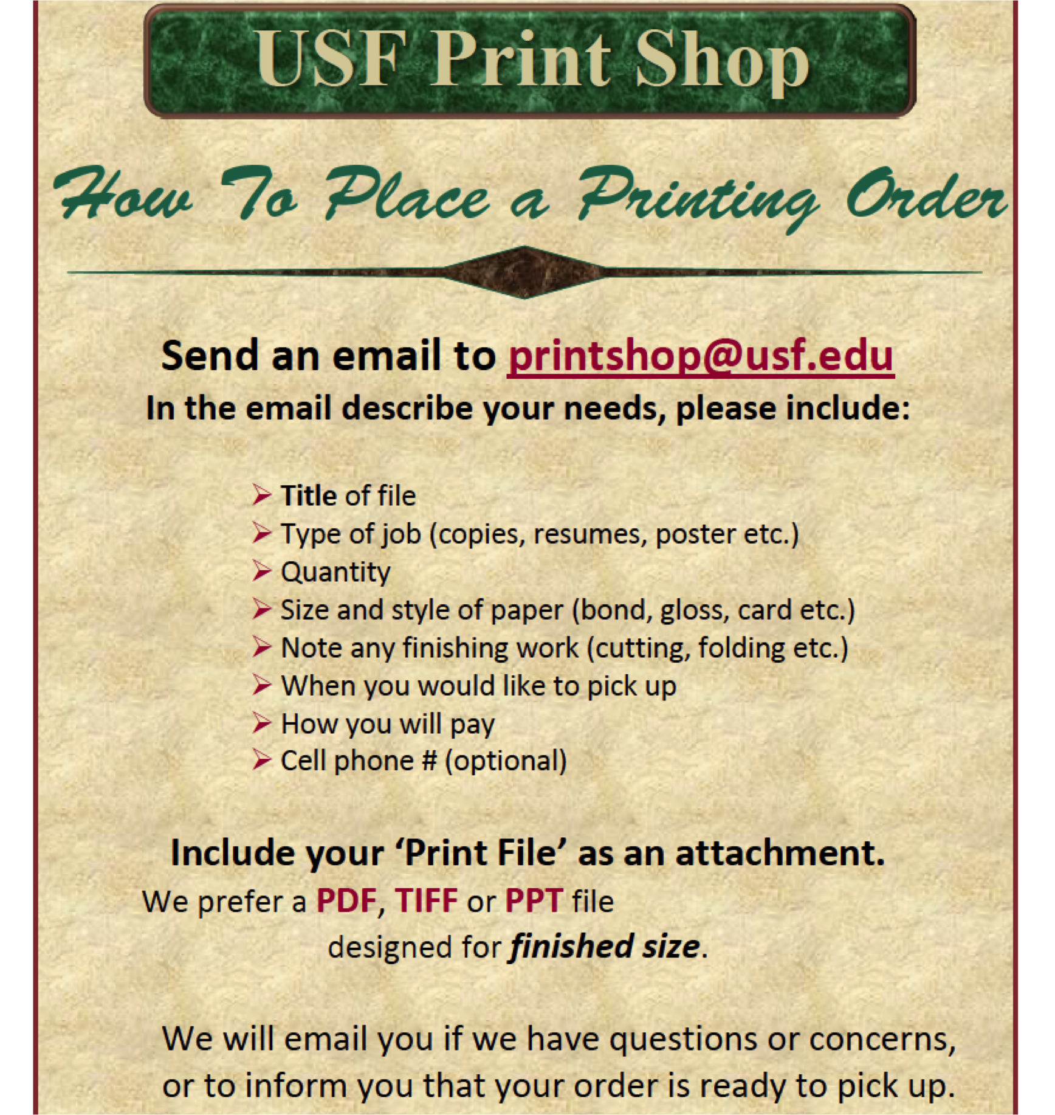

Slide 9
Layout and design
Simplicity.
Tell the story but not the details
Explain:
  what the grant is
  why it’s important (for the community, for the client, for the health sciences)
  what your plan of action is

Slide 10
Mounting your finished product
Purchase foam board at Staples, Office Depot, etc.
Use thumb tacks to attach the poster to the foam board. You can do the day of the presentation.
If you need to store materials in my office, let me know when you will drop them off.

Slide 11
Examples
Pimp my Poster --feedback from peers
PhD Posters-- nontraditional designs
Colin Purrington-- poster templates and design

