Slide 1
Cover Letters
A guide to crafting cover letters
Notes:
Discuss readings as we go through

Slide 2
About
Cover letters serve as an introduction of you and your resume to potential employers
This is the first document those people will see
If there are several candidates vying for one position, you will want your cover letter (and supporting materials) to be as attractive and persuasive as possible
This is a great opportunity to impress an employer
Notes:
Potential employers or affiliations and organizations you seek to join (read: INTERNSHIPS)

Slide 3
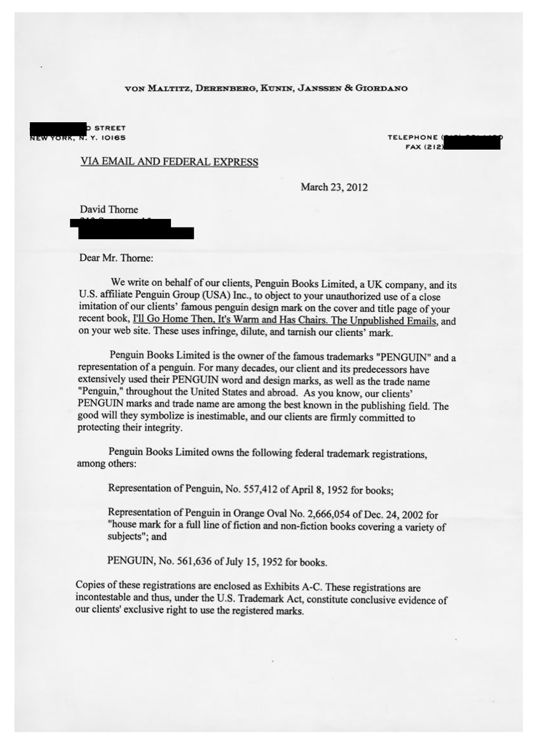
Attractive & Persuasive?
Time permitting:
Trademark Infringement / Legal Letters - David Thorne

Slide 4
Cover Letters
This is where your research about the job comes in handy
Tailor the document to each employer
This may take more time, but it shows that you are a serious
candidate
Use this space to create a narrative with the material from your resume
This serves as a great writing sample, and you should be able to adjust the content for similar jobs.
Notes:
Talk about horror stories from All Seasons Communication—getting applications that have cover letters for some other company

Slide 5
Formatting
Single-space
One space after each paragraph
Three spaces between last paragraph and closing (sincerely)
One space between contact info and salutations
Align all paragraphs to left
Sign your name in ink

Slide 6
Address
Address your cover letter to someone specific; avoid sending a letter to a department or an organization
What if there isn’t a specific person to contact on a website or add?
Call and inquire!
If all else fails, address your cover letter “Dear Hiring Professionals” or “To Human Resources at (Name of Company,” or something similar (avoid “To whom it may concern, as this has become commonplace).
Notes:
Larger companies often have standard procedures for dealing with solicited and unsolicited resumes and cover letters. Sending your employment documents to a specific person increases the chances that they will be seriously reviewed by the company.
When a job advertisement does not provide you with the name of the hiring authority, call the company to ask for more information. Even if your contact cannot tell you the name of the hiring authority, you can use this time to find out more about the company.

Slide 7
Introduction
Salutations, i.e., Dear Mr. Smith, or Dear Ms. Jones
Include:
Who are you?
Why are you writing?
How did you come to learn about this position?
Make sure your reference is on good terms with the organization!
How do your values align with those of the organization? What about their goals? Missions?
Notes:
Many people hear of job openings from contacts associated with the company. If you wish to include a person's name in your cover letter, make certain that your reader has a positive relationship with the person.
In some instances, you may have previously met the reader of your cover letter. In these instances it is acceptable to use your introduction to remind your reader of who you are and briefly discuss a specific topic of your previous conversation(s).
Most important is to briefly overview why your values and goals align with the organization's and how you will help them. You should also touch on how you match the position requirements. By reviewing how you align with the organization and how your skills match what they're looking for, you can forecast the contents of your cover letter before you move into your argument.

Slide 8
Argument
Why are you the most fit candidate? Demonstrate your skills and experience here
DO NOT mention other candidates. Whether you know them or not, it is VERY BAD to bring anyone other than you into this limited space!
Use your research about the company. Impress them!
Keep your tone smart, motivated, and up-beat!
Do the above without emoticons. ☹
Notes:
You want your argument to be as powerful as possible, but it shouldn't cloud your main points by including excessive or irrelevant details about your past. In addition, use your resume (and refer to it) as the source of "data" you will use and expand on in your cover letter.

Slide 9
Argument
Make them know and understand the benefits you will bring to their team
Each paragraph should contain a reason validating your expertise and proving your worth
Finally, a picture!

Slide 10
Conclusion
Restate how your values align with the company’s
Restate how you align with their goals and missions
Let them know that you’ll contact them (and when)
Leave your contact information (phone, email)
Thank them
Notes:
Although this closing may seem bold, potential employers will read your documents with more interest if they know you will be calling them in the future. Also, many employment authorities prefer candidates who are willing to take the initiative to follow-up. Additionally, by following up, you are able to inform prospective employers that you're still interested in the position and determine where the company is in the hiring process. When you tell readers you will contact them, it is imperative that you do so. It will not reflect well on you if you forget to call a potential employer when you said you would. It's best to demonstrate your punctuality and interest in the company by calling when you say you will.

Slide 11
Cover Letter vs. Personal Statement
Similar in principal, different in organization.
If asked for a personal statement, follow similar rules about content, but consider the following organization:
Personal (anecdote about family or personal experience to show motivation and dedication)
Academic/Professional (reference and expand on specific coursework or projects that are relevant)
Service/Extracurricular (one anecdote that points to your character/leadership)

Slide 12
Review
Review and revise!

