Slide 1
Project 1
100 points
Due: October 2, 2018
Format Decision Due: September 11, 2018

Slide 2
Instructions
Choose an invasive species (plant or animal) to research.
National Invasive Species Information Center: http://www.invasivespecies.gov/
Center for Invasive Species and Ecosystem Health: http://www.invasive.org
Describe the invasive species in detail.
Provide background on the species and its native environment.
Describe the non-native ecosystem in which the invasive species is found.
Describe some techniques being used to manage the species.
Explicitly state whether more or less should be done to manage the species.
Support your position

Slide 3
Instructions
Some questions to think about:
Where did the species originate?
What are the species’ defining characteristics?
Does it have any natural predators?
Where has the invasive species spread?
How was it introduced to the non-native environment?
What are the consequences/rewards of the invasive species inhabiting the new environment?
What kind of impacts has the invasive species had on the non-native ecosystem?
What effects has it had on other wildlife and the biodiversity of the ecosystem? Humans? The economy?

Slide 4
Formats
Research Paper
Brochure/Pamphlet/Poster
Video/Recorded Lecture
Must fill out survey notifying me what format you will be using.
15 points will be subtracted from your final project if you do not
Every project must have a “Works Cited” page and in-text citations where applicable

Slide 5
Research Paper
MLA format
3 - 4 pages (Not including Works Cited section)
Times New Roman font
Double-spaced
1-inch margins
12-point font
No more than 2 sentences or 3 lines of quotations.
Indent each paragraph
No extra spacing between paragraphs
.doc, .docx, or .pdf format
Paper written as a research paper and not a series of short-answer questions
Will only accept submissions to Canvas/Turnitin
Will not accept writing projects sent to me through email or Canvas message attachments
Must work alone

Slide 6
Poster/Pamphlet/Brochure
Use diagrams, photos, and images to present information about your invasive species.
Posters can be made in PowerPoint by making the slide size 20 inches x 30 inches or on poster board
Must include 1.5 - 2.5 pages of information text using the formatting guidelines from the research paper above to be submitted through Canvas as a .doc, .docx, or .pdf file.
This information can be sized/displayed however you would like on your poster/brochure/pamphlet, but a document with only the text must also be provided.
Make it visually appealing and interesting!
You can work in pairs
Both need to submit files on Canvas with both names at the top.

Slide 7
Video/Recorded Lecture
Record a video (7-10 minutes long)
Can be giving a lecture
Can be a general video
Must include a script of text using the formatting guidelines from the research paper above to be submitted through Canvas as a .doc, .docx, or .pdf file.
You can work in pairs, but both of you must be featured in the video fairly equally.

Slide 8
References/Citations
Must have “Works Cited” or “References” section at end of paper
Does not count towards page limit
At least 3 references
Cannot be Wikipedia
MLA
http://www.bibme.org/mla
Must use in-text citations for all information from a source.
Harvard Method (Author Last Name, Publishing Date)
Examples
One author: (Evans, 2005)
Two authors: (Evans & Kasbohm, 2015)
Three or more authors: (Kasbohm et al., 2015)

Slide 9
References/Citations
Example
Though the assembly of the supercontinent Pangea is fairly well-constrained, the supercontinent of Rodinia has many possible assemblies supported by current observations (Evans, 2013).

Slide 10
Rubric
Specific rubrics for each format are available through Canvas

Slide 11
Submission
Must submit written component through Turnitin on Canvas.
Submitted as a .doc, .docx, or .pdf file
Physical posters/brochures/pamphlets must be turned in to the instructor by 5PM on due date
Digital files can be attached to your Canvas submission as a comment.
Videos can be uploaded as a YouTube video with the link provided as a comment to the Canvas submission.
Late submissions receive -20 points per day after deadline
Technical difficulties or problems with Canvas are no excuse for not turning in writing projects on time.

Slide 12
Helpful Websites
Guide to writing a research paper
http://www.aresearchguide.com/1steps.html
MLA Format Guidelines
http://www.bibme.org/mla
In-Text Citations
https://en.wikipedia.org/wiki/Parenthetical_referencing
Generating References/Works Cited
http://www.citationmachine.net/mla/cite-a-website
Writing Help (USF Writing Center)
https://www.lib.usf.edu/writing/
Turnitin Guidelines
https://guides.turnitin.com/03_Integrations/Turnitin_Partner_Integrations/Canvas/Turnitin_LTI_1.0/Student/03_Submitting_a_Paper
https://guides.turnitin.com/01_Manuals_and_Guides/Student_Guides/Turnitin_Classic_(Deprecated)/09_Submitting_a_Paper

Slide 13
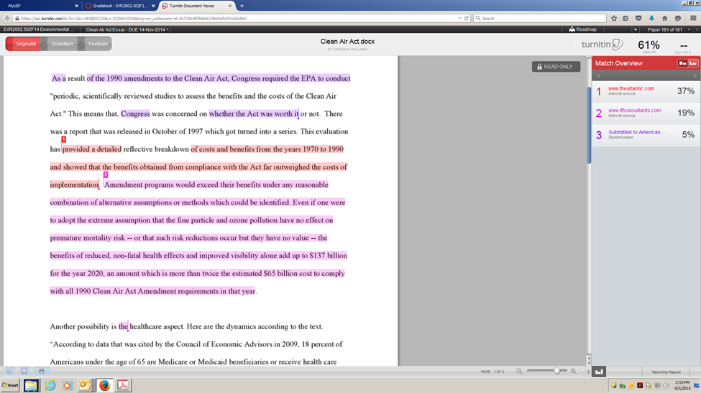
Turnitin

Slide 14
Canvas/Turnitin Issues
Here are some websites to help with paper submission using Turnitin through Canvas:
https://guides.turnitin.com/03_Integrations/Turnitin_Partner_Integrations/Canvas/Turnitin_LTI_1.0/Student/03_Submitting_a_Paper
https://guides.turnitin.com/01_Manuals_and_Guides/Student_Guides/Turnitin_Classic_(Deprecated)/09_Submitting_a_Paper
Please refer to these first.

Slide 15
Canvas/Turnitin Issues
Things to try:
Changing computer time zone
If set to different than EST, may mess with submission near deadline
Change file type
Change to a file type suggested by Turnitin & Canvas
Copy & Paste into a text submission

Slide 16
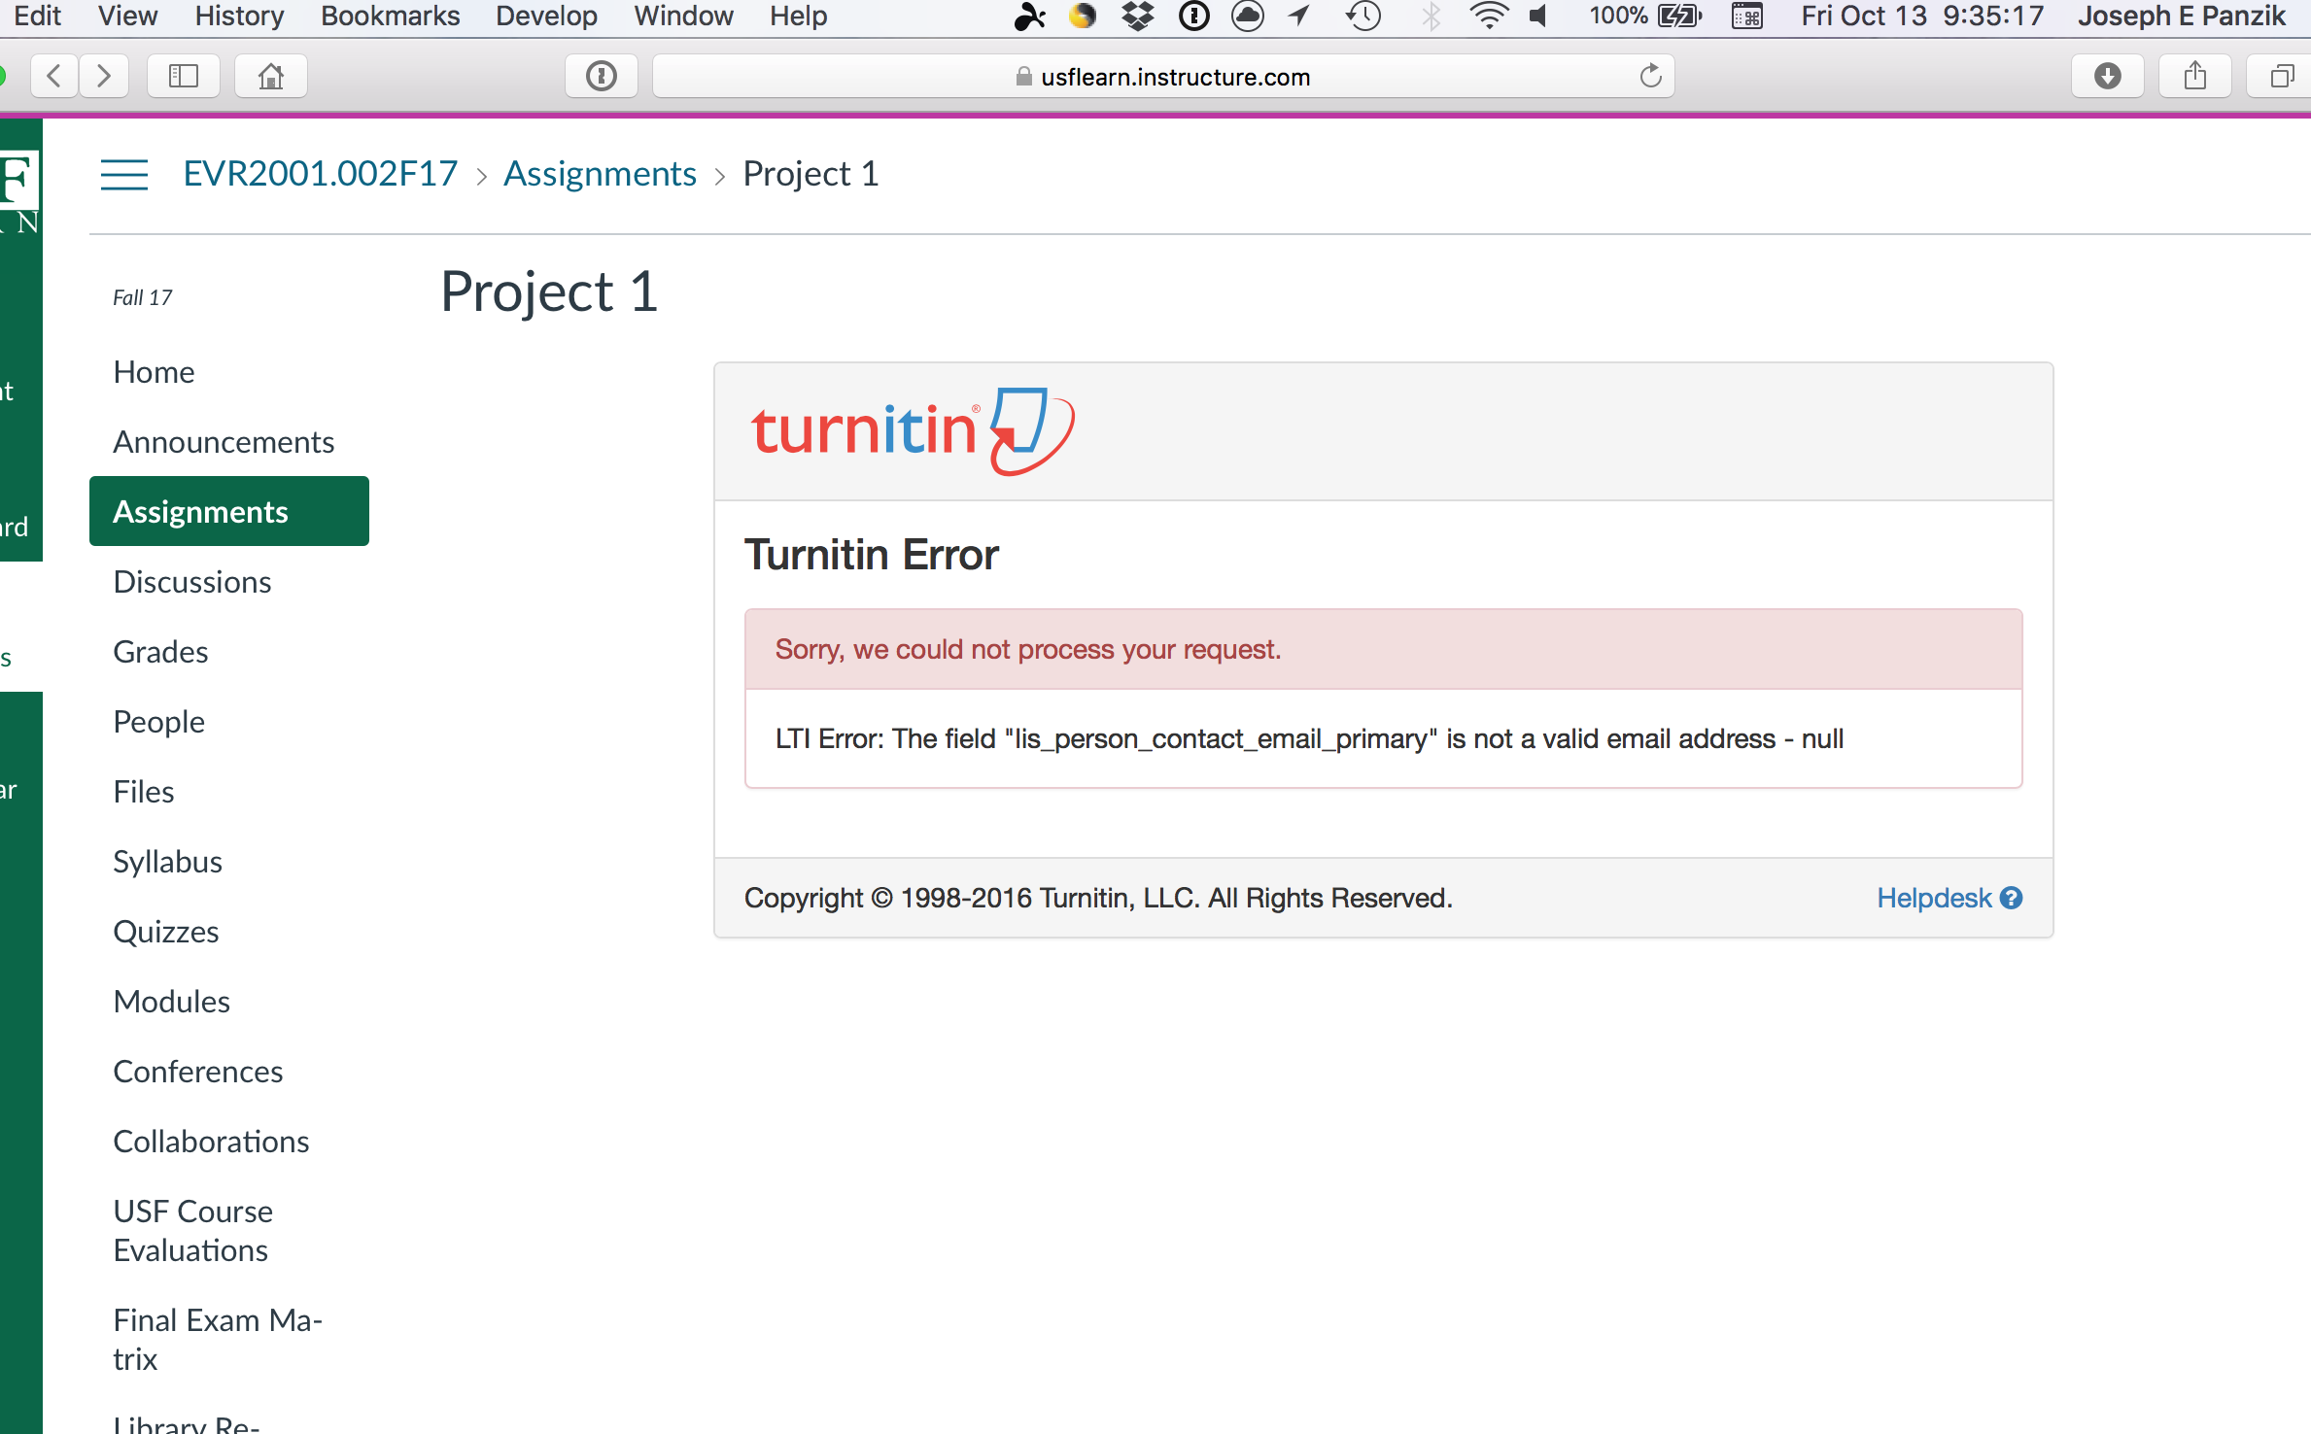
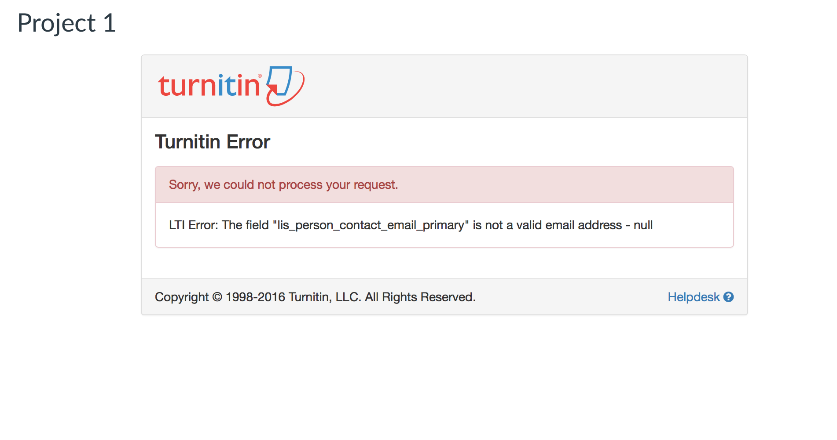
Canvas/Turnitin Issues
If you are still having issues:
Take a screen shot of your computer including some markers that identify it as your computer

Slide 17
Canvas/Turnitin Issues
“I uploaded the wrong file!”
Oh No! That stinks!
Canvas and Turnitin should allow you to review your submission before you hit submit.
Please review your submission to make sure
You only get 1 submission. If you submit the wrong file, you must email me so that I can clear your original submission.
I will automatically deduct 5 points for the wrong submission, so be careful.

