Slide 1
Orientation &
Preparation for
The
ALC
Active Learning Classroom
Environment

Slide 2
Agenda
1. ALC & Rationale
2. Best Practices/Tips
3. Challenges and Solutions
4. How do I get started?
5. Demonstration - IS

Slide 3
What is Active Learning (AL)?
“Involving students in doing things and thinking about what they are doing”
Bonwell and Eison (1991)

Slide 4
AL
Rationale

Slide 5
Benefits of Active Learning
Information Recall
Academic Performance
Conceptual Understanding
Misconceptions

Slide 6
More Benefits
Retention
Student Engagement
Critical Thinking Skills
Professional Skills

Slide 7
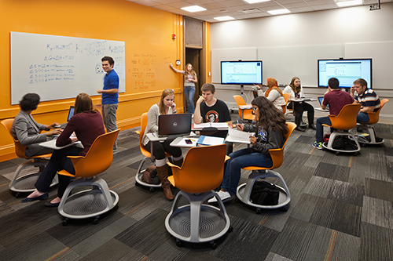
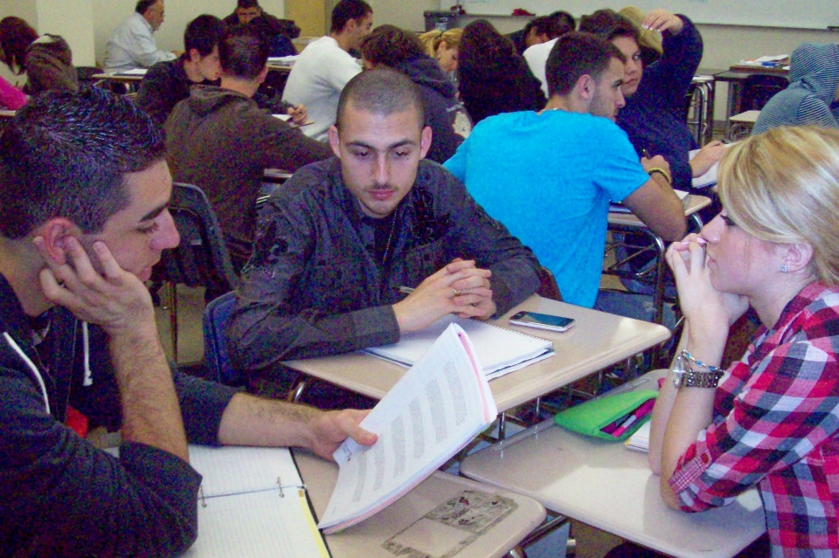
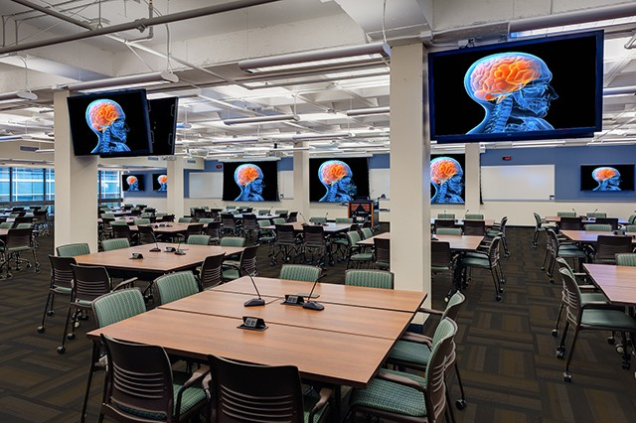
AL
Classroom
ALC
Pedagogy
+
Space Design
+
Technology
=
NOW
BEFORE

Slide 8
Best Practices/TipS

Slide 9
Best Practices/Tips
Tip
Tip
Share AL rationale
Provide feedback opportunities
Tip
Tip
Share your teaching philosophy
Be flexible and adapt
Tip
Tip
Explain the Paradigm shift
Switch teaching strategy
Be prepared

Slide 10
Challenges
Solutions

Slide 11
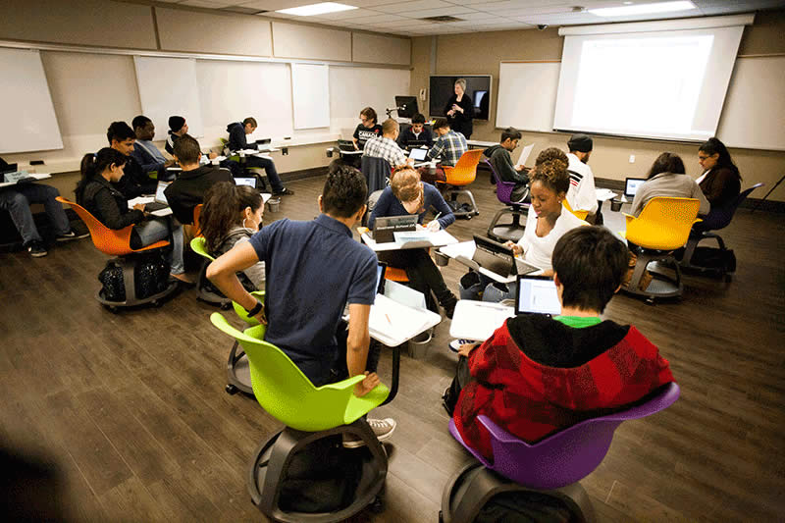
Classroom Management
Challenge
Solutions
Establish a visual cue
Flicker light
Busy environment = Noise

Slide 12
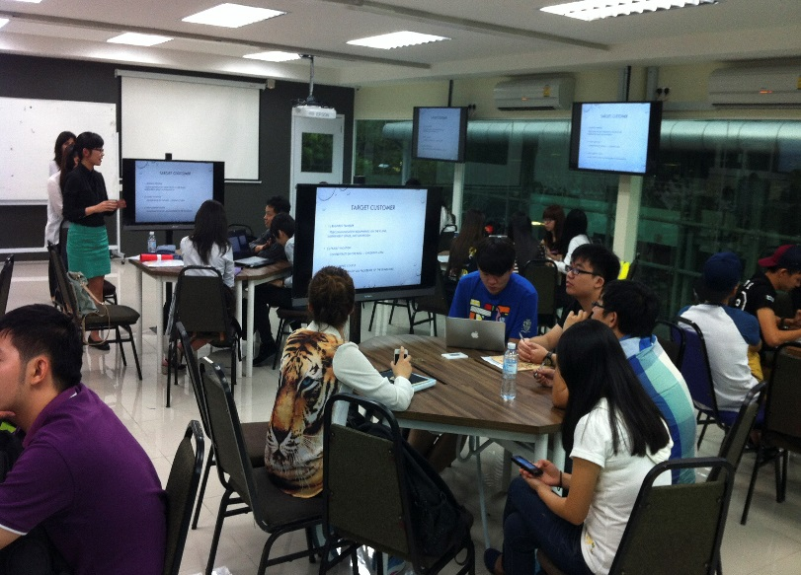
Classroom Management
Challenge
Solutions
Student is off-task
or disengaged
Circulate, interact & give feedback
Limit # connected devices
Assign student roles
Set time limit

Slide 13
Classroom Management
Challenges
Possible solutions
Students with documented accommodations
Follow SDS protocols
Be willing to accommodate

Slide 14
Technology
Challenges
Solutions
BYOD Connectivity
Laptops
USF Health Secure Network

Slide 15
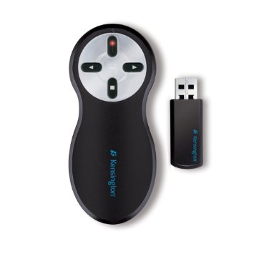
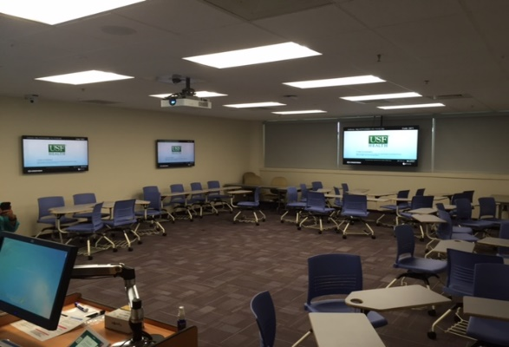
Technology
Challenges
Solution
Ability to control the presentation in ALC
Remote control clicker

Slide 16
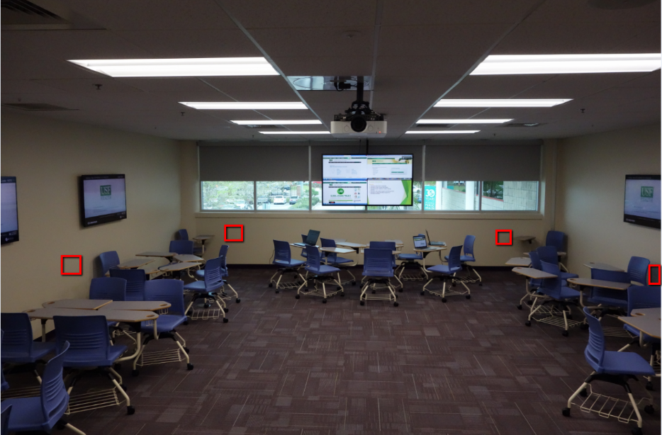
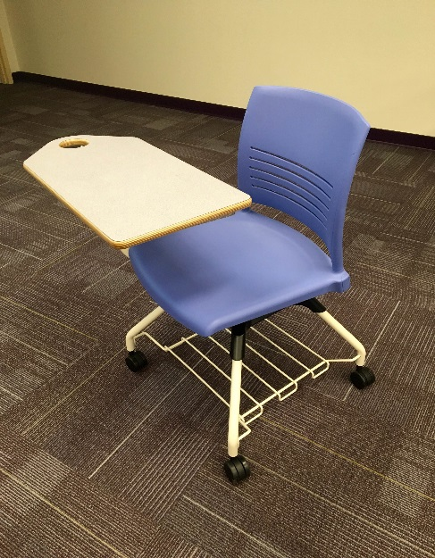
Room configurations
Challenges
Solution
Multiple Focal points
Flexible student station

Slide 17
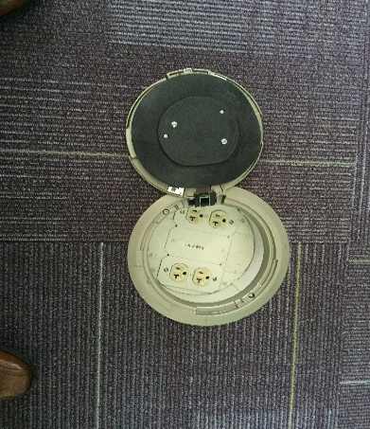
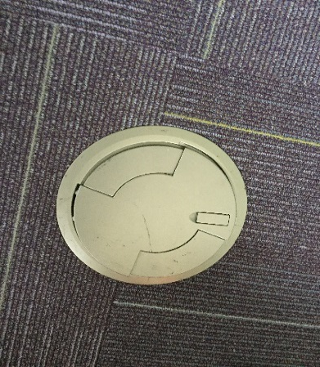
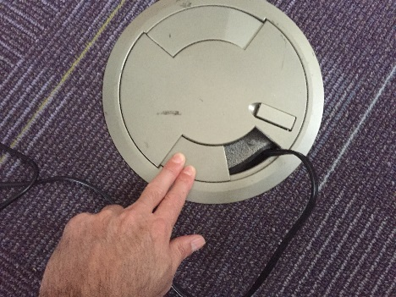
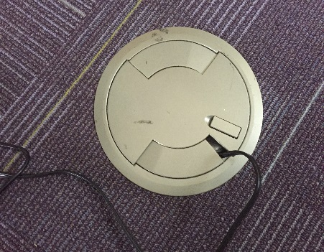
Room Safety
Challenges
Solution
Open Power outlet lid
Proper use

Slide 18
Designing an Active Learning Activity
ETA
On Your Own
Instructional Design Strategies Document
Consult: Analysis & Development
Active Learning Strategies by Session Timeline
Customize Activity to your lesson
Active Learning Repository

Slide 19
References
Active Learning Strategies in Face-to-face Courses
Teaching and Learning in Active Learning Classrooms
Active Learning in Odegaard Library. Report on Year 1 of UW’s Active Learning Classroom
Best practices for Teaching in Active Learning Classrooms [University of Washington]
Active Learning Classroom [University of Minnesota]
Active Learning: Creating Excitement in the Classroom Bonwell & Eison (1991)

