Slide 1
Active Learning Classroom(ALC) at COPH
Agenda
01
Overview
02
Demo
03
Activity
04
Open Floor
01 Overview
02 Health IS
03 Activity
04 Open Floor
Describe ALC, rationale for use
Demonstrate capabilities of COPH ALC
Break out activity
Interactive walk through of the ALC

Slide 2
https://www.youtube.com/watch?v=Z9-CCPUVBow

Slide 3
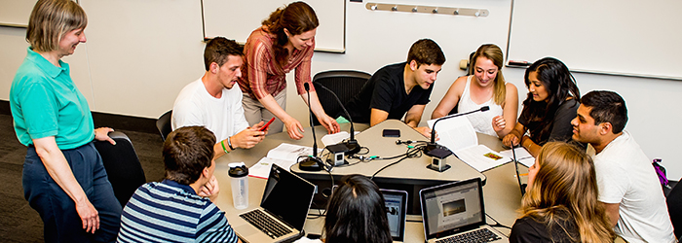
A more technical definition
“Active Learning is a process whereby students engage in activities, such as reading, writing, discussion, or problem solving that promote analysis, synthesis, and evaluation of class content”
[University of Michigan Center for Research on Learning and Teaching]

Slide 4
Why Active Learning?
Increase
Retention
Increases retention levels
Effective
Peer teaching and learning is effective when learning new content
Peer Teaching and Learning
Produces
Cognitive Outcomes
Better cognitive outcomes
Develop
Develop professional skills for the workplace
Professional Skills

Slide 5
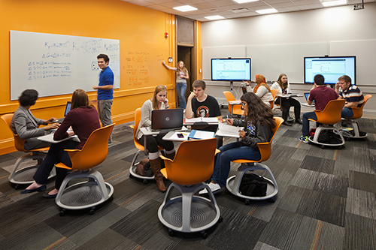
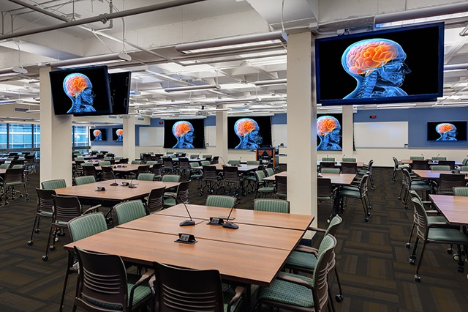
So how are active learning
classrooms designed today?
Pedagogy
+
Space Design
+
Technology
=
ALC
NOW
BEFORE

Slide 6
Classroom Principles
ALC provides
ALC allows
ALC gives
ALC aids
Flexible and adaptable learning platform
a shift in faculty and student roles
students multiple ways to process information
Student collaboration and reduces anxiety

Slide 7
When and where during my lesson do I implement an AL activity?
After Lecture
Activities that clarify lecture misconceptions
Collaboration
Activities that engage students in peer teaching and learning
Begin/End
After lecture delivery
Warm-ups/Review
Group Activity
Activities to check prior knowledge and check understanding of lecture content
Discussion
Relevance
Activities that tap into student’s life experience in connection with new content

Slide 8
How do I go about designing my activity:
Timeline
Customize Activity
2 weeks analysis and development
Activities can be collaboratively designed to tailor your course and your session objectives
OPTION 1: ETA Consult
Strategies
Repository
OPTION 2: On your own
Use the Instructional Design Strategies document to think through your course needs
A collection of activities, ideas, articles pertaining to AL is hosted at this link.

Slide 9
So…what was the purpose for ALC at COPH now?
Recommendations
Collective faculty input from multiple work groups indicated using Active Learning strategies
Workgroup recommendations
Feedback
Student’s evaluations and informal feedback suggest students wish to interact with content, faculty and their peers.
Student feedback
Lecture
Largely lecture based
Most COPH courses employ a lecture-based approach
TMPH
Evaluation data from the TMPH pilots suggest students learn better during Active Learning sessions
TMPH lessons learnt

Slide 10
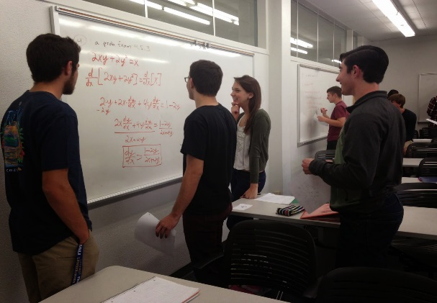
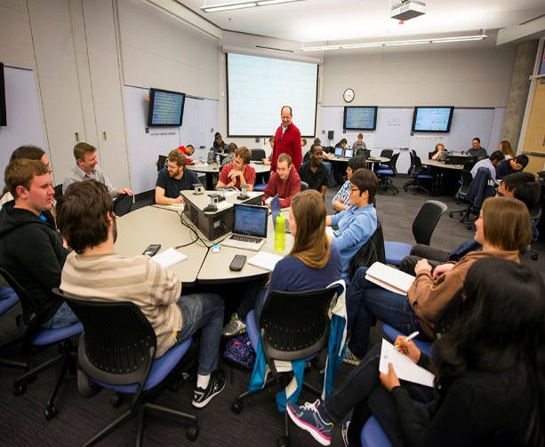
The most important paradigm shift…
Faculty led to student led
Facilitating Learning vs Relaying lecture content

Slide 11
ALC Guidelines
Strategies
Capabilities
Assistance
Process
Familiarize faculty about Active Learning, strategies and tips
Share specific technical capabilities within COPH ALCs
Provide avenues for technical and pedagogical assistance in using ALC
Currently being reviewed to work with 25Live processes

Slide 12
ETA Goals
Goal 3
Goal 2
Goal 1
Goal 2
Goal 3
Increase your pedagogical Active Learning repertoire
Assist in design and development of effective AL activities
Work together to ensure successful experience for all in ALC
Goal 1

Slide 13
Moving forward…
Support
Training
Support
ETA will proactively reach out to all summer faculty who are scheduled to teach in ALCs
Orient and train
Work on activities together
Implement in classroom
Future Training & Showcase
Suggest topics of interest to you!
Training
ALC
Learning Experience
ALC
Learning
Pedagogy + Space Design + Technology = ALC
ETA + Facilities + Health IS = COPH ALC
Use us as a resource, we will learn alongside you!

Slide 14
References
Active Learning in the College Classroom
Using Active Learning Instructional Strategies to Create Excitement and Enhance Learning
Active Learning: Creating Excitement in the Classroom
Learning Environments: Where Space, Technology, and Culture Converge

