Slide 1
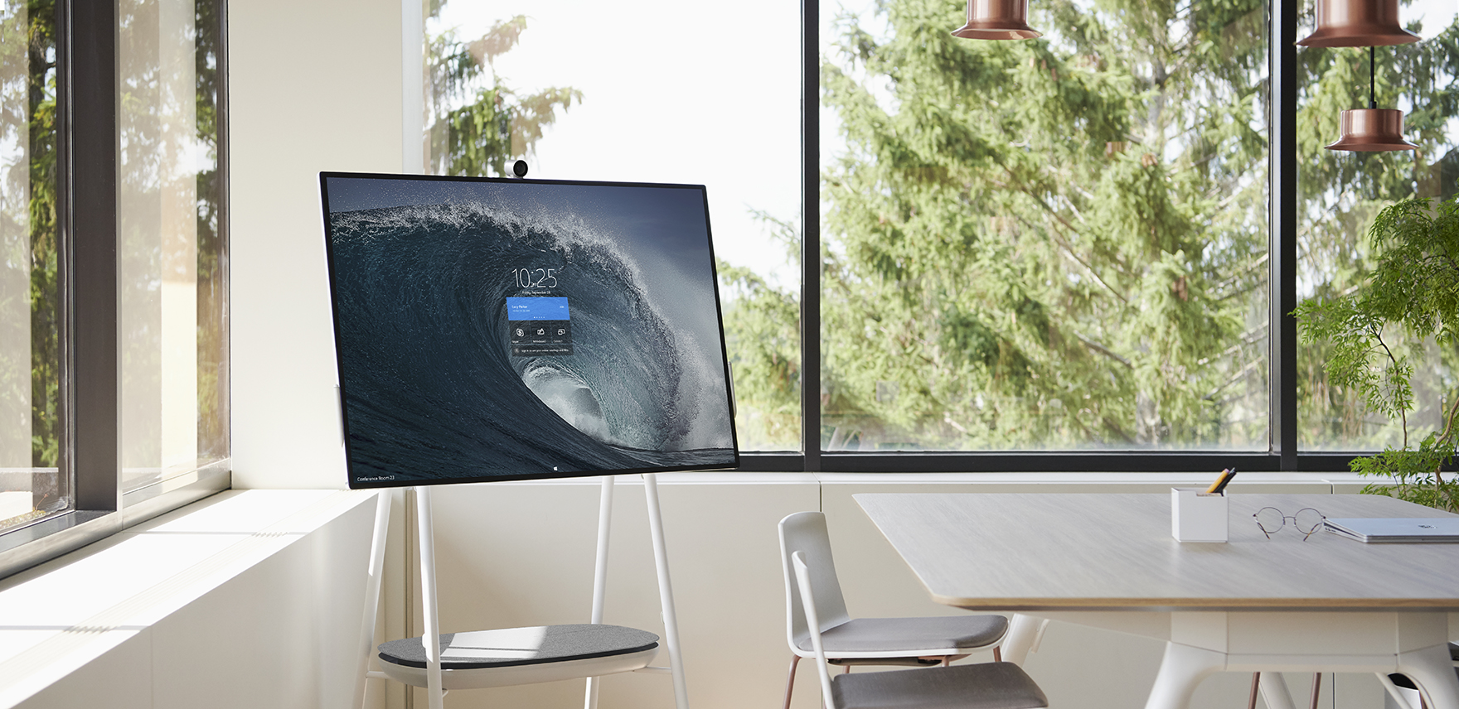
Surface Hub 2S Navigation Guide

Slide 2
Table of contents
Welcome screen – Where every session starts
Start menu – Launch apps, sign in, access your files
App workspace – Multitasking with apps
Full screen – Switch in and out of full screen
Clip to the whiteboard – Capture the screen to the whiteboard
Task view – Switch and close apps
End session – Close out a session and return to Welcome screen
More options and notifications – Change volume, Do not disturb, Restart

Slide 3
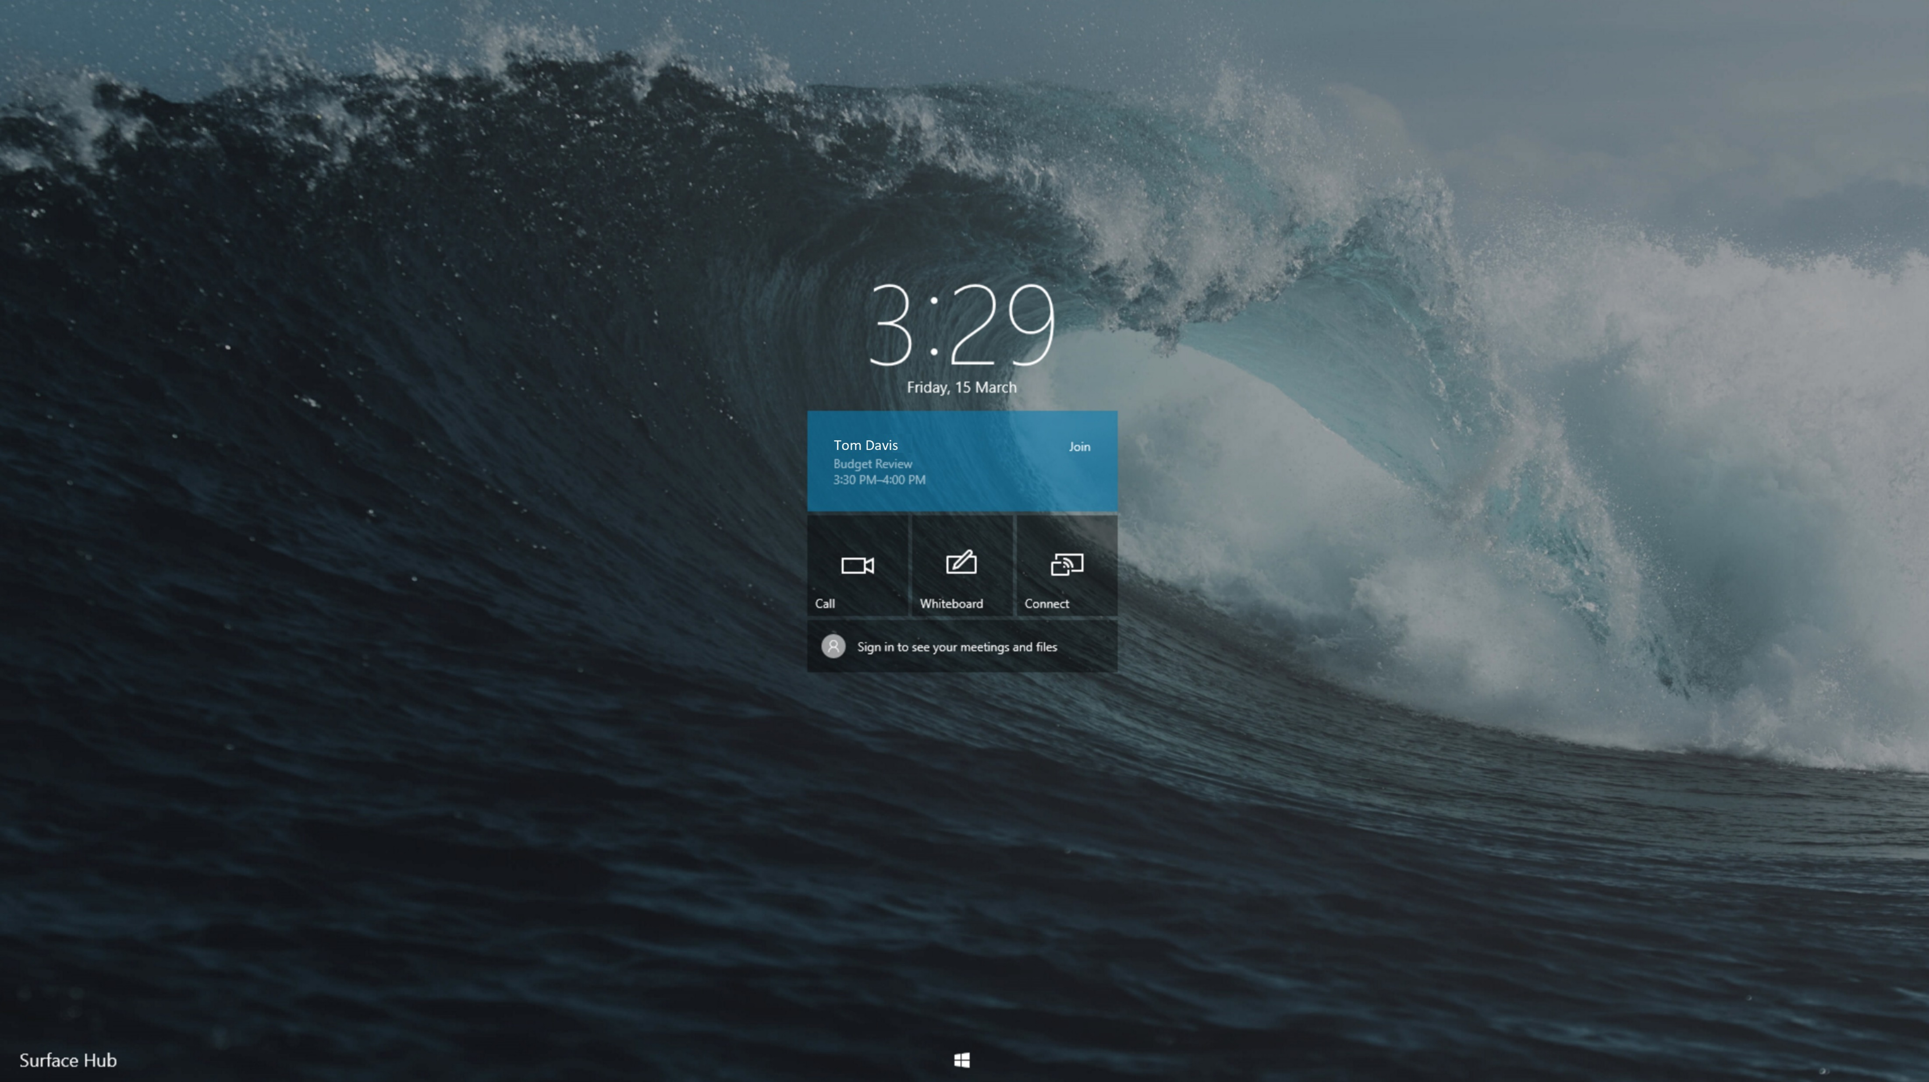
<- Back to Table of Contents

Slide 4
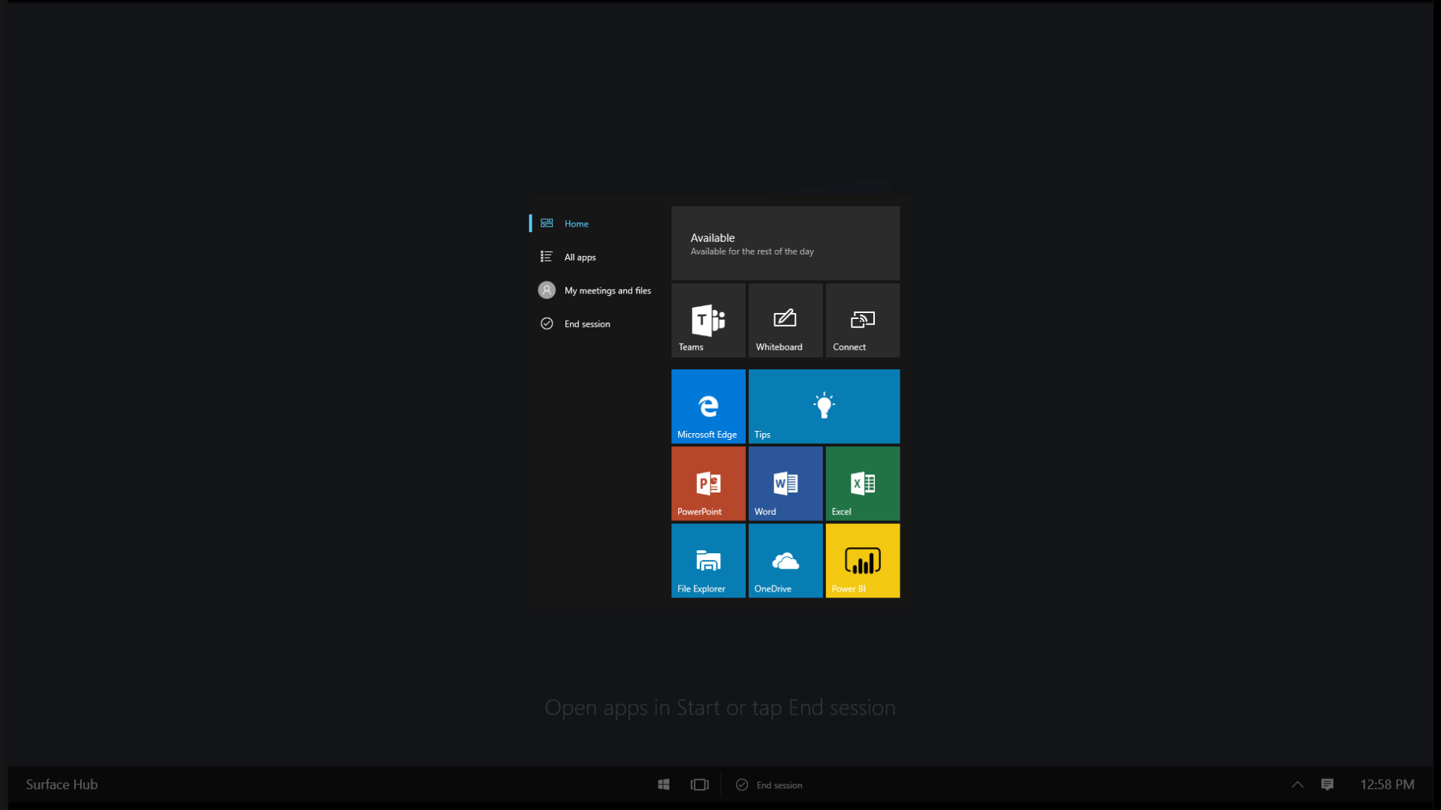
<- Back to Table of Contents

Slide 5
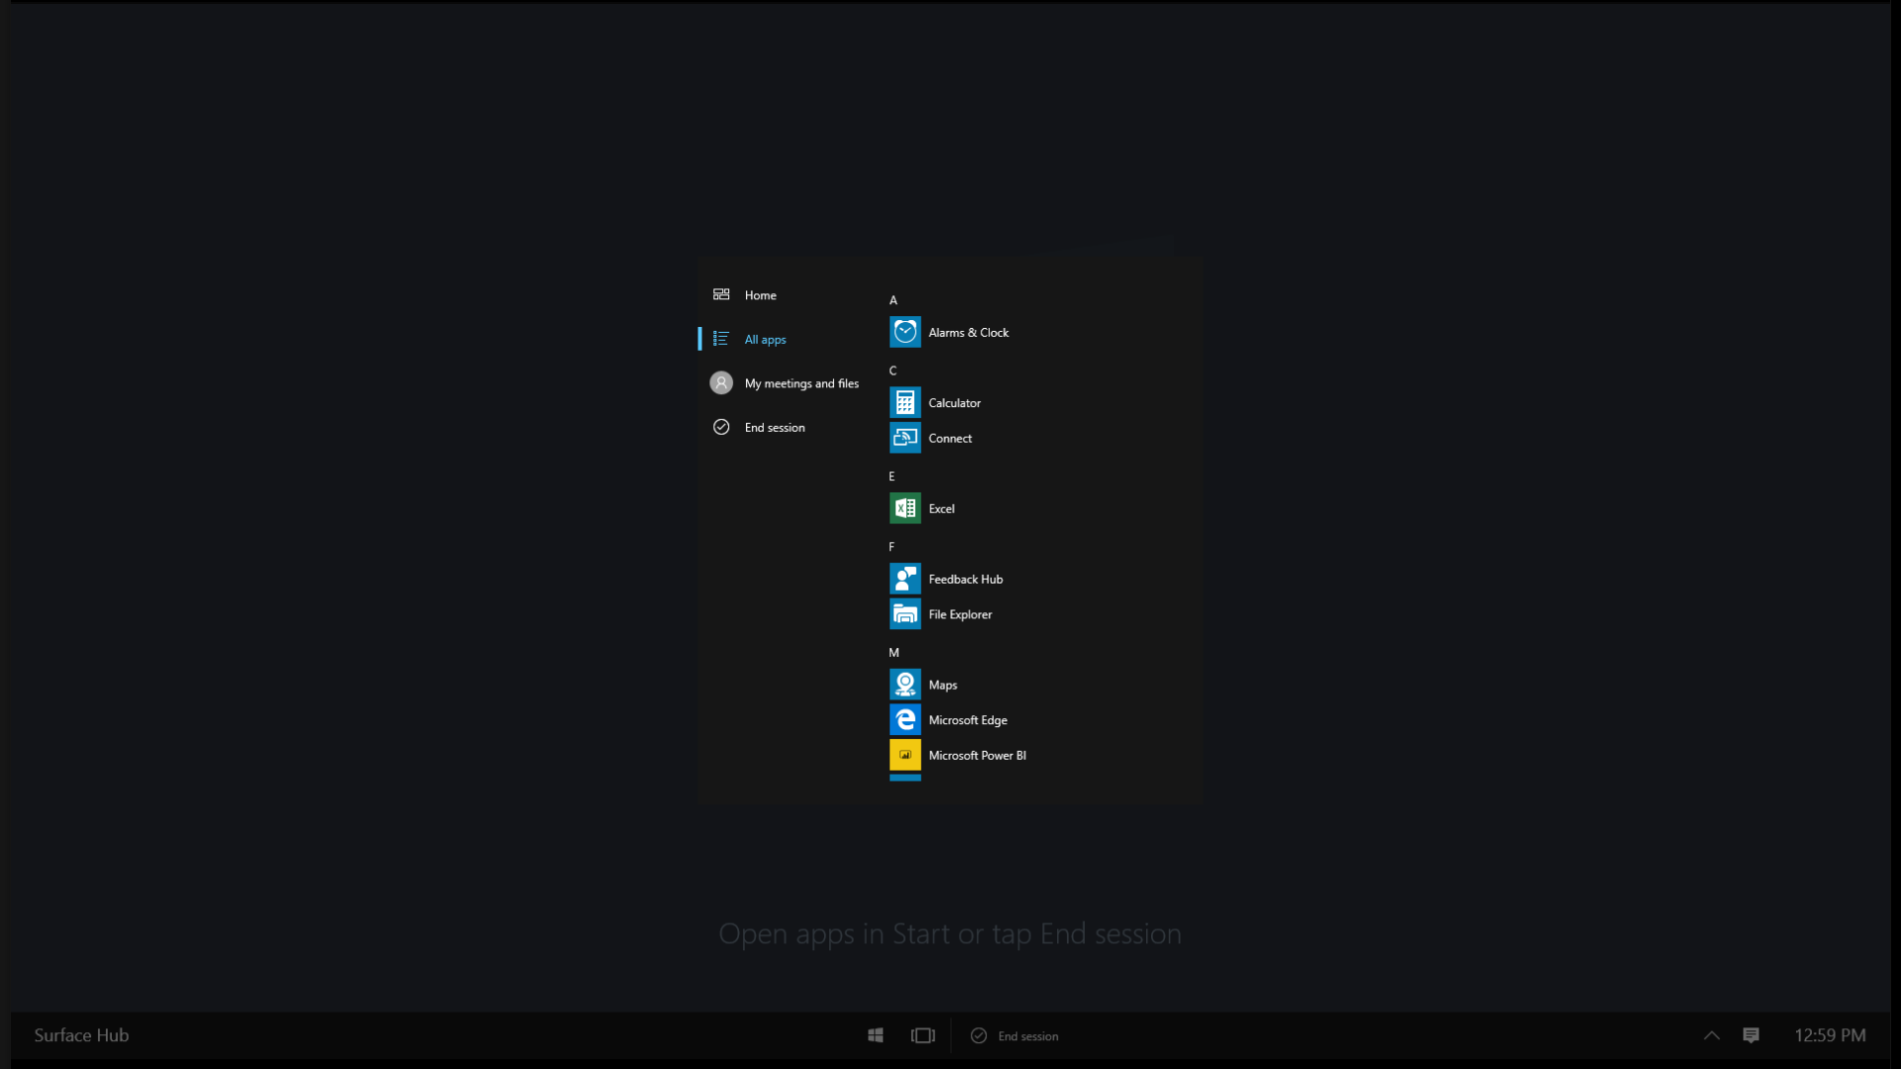
<- Back to Table of Contents

Slide 6
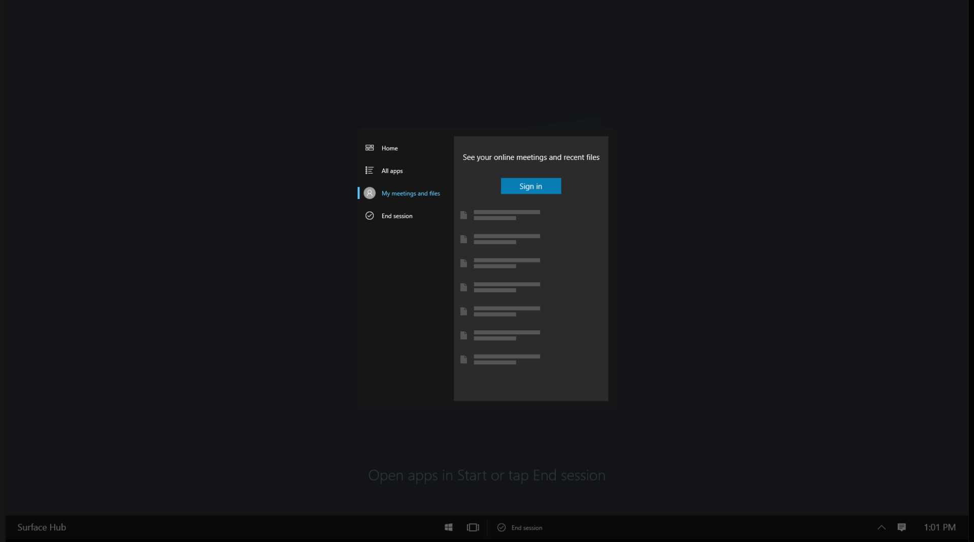
<- Back to Table of Contents

Slide 7
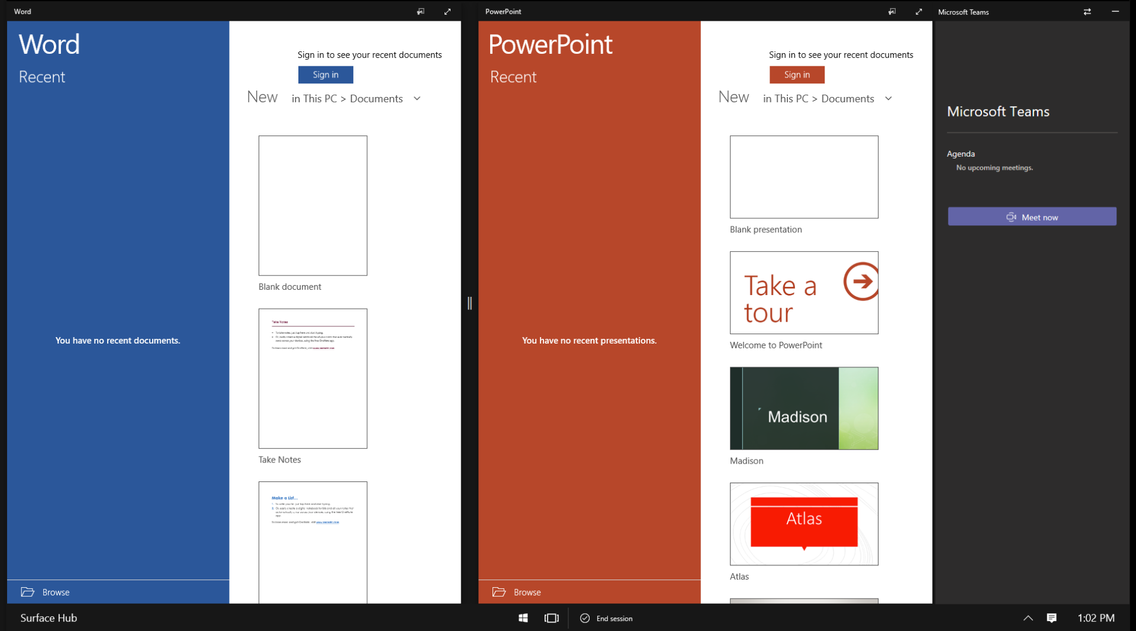
<- Back to Table of Contents

Slide 8
<- Back to Table of Contents

Slide 9
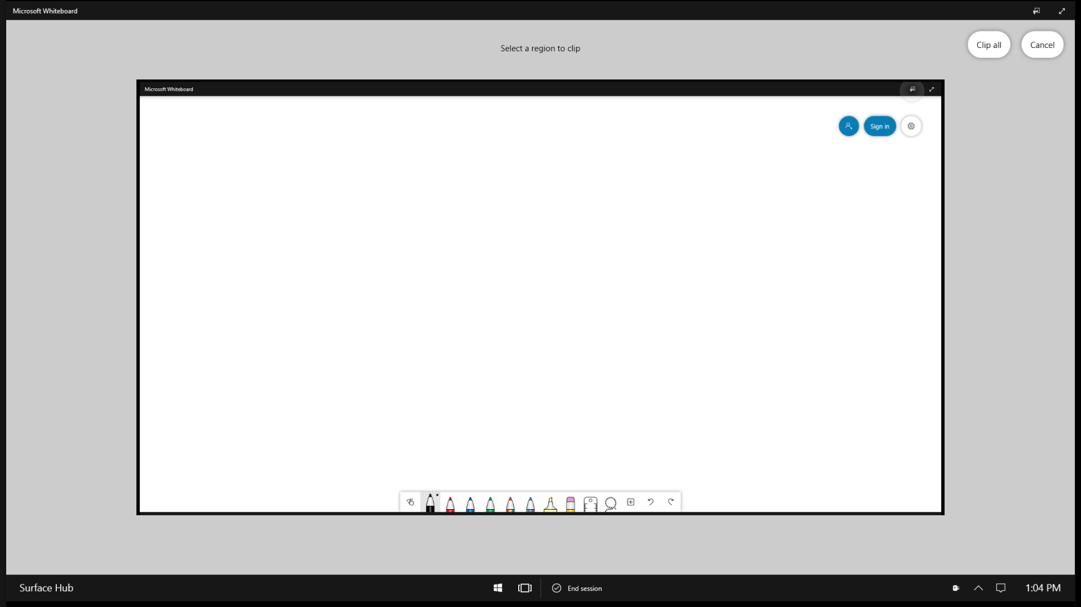
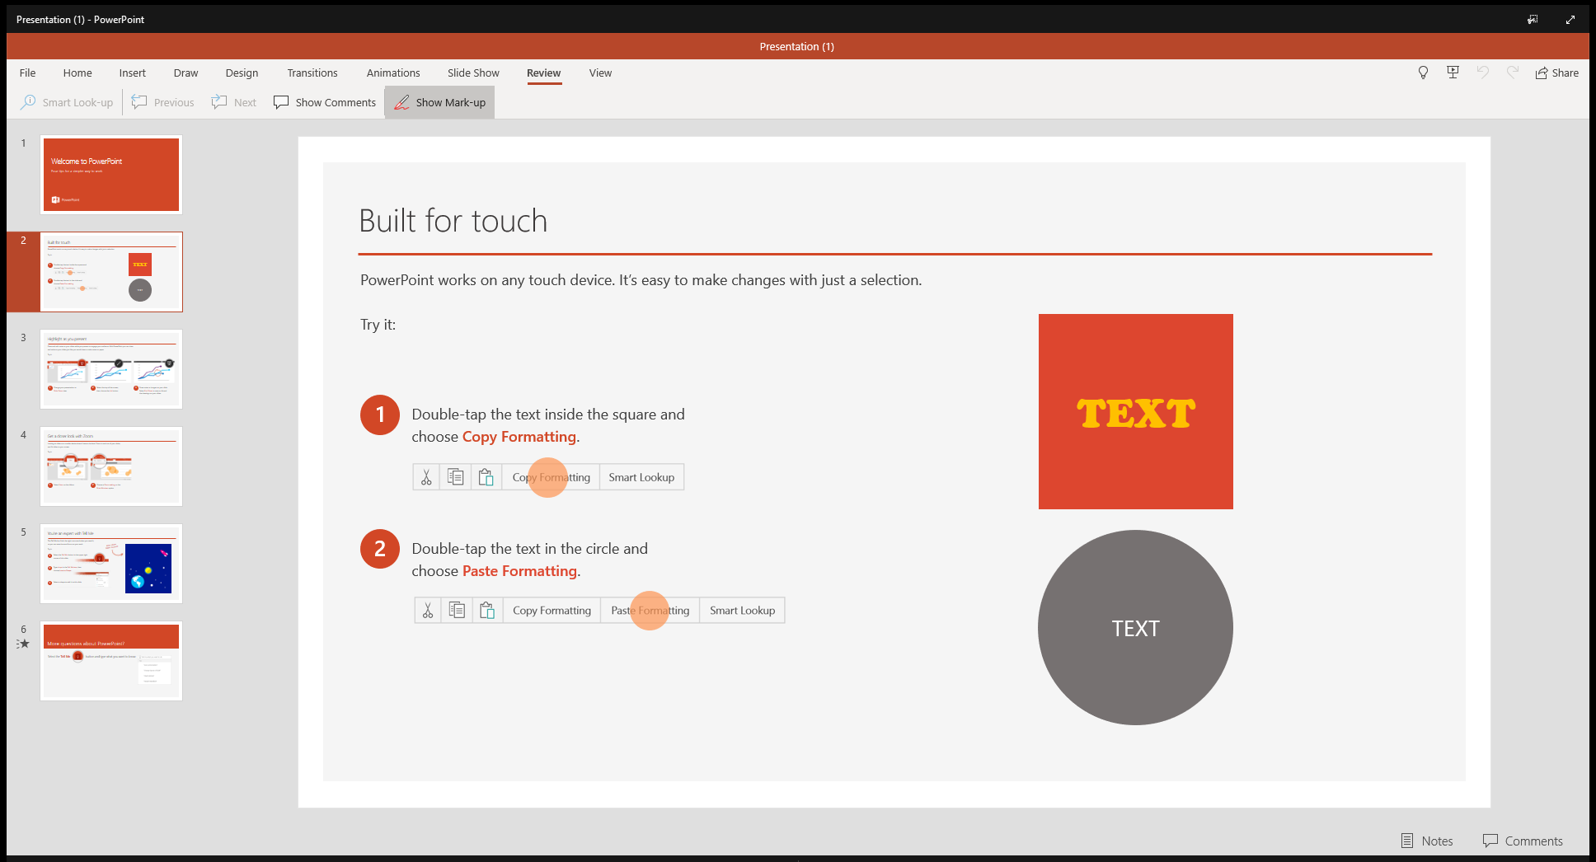
<- Back to Table of Contents

Slide 10
<- Back to Table of Contents

Slide 11
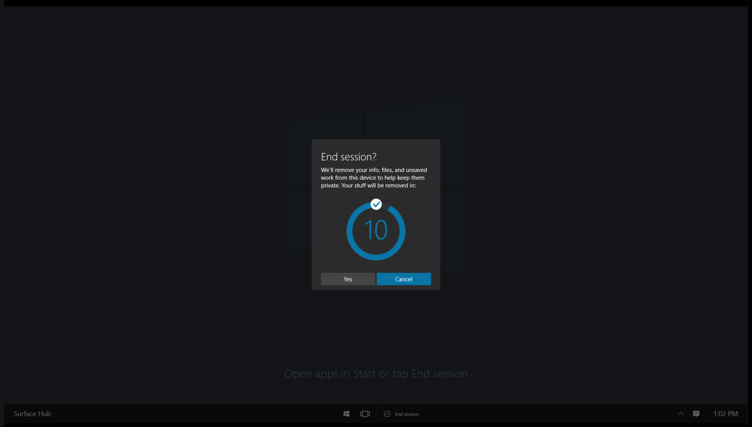
<- Back to Table of Contents

Slide 12
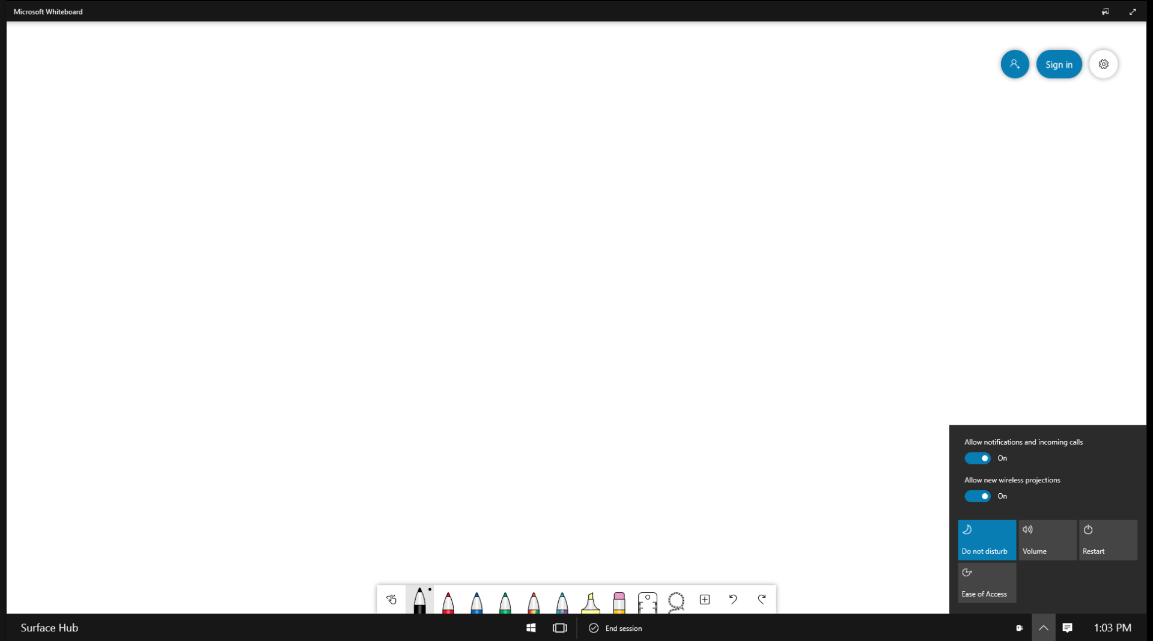
<- Back to Table of Contents

Slide 13
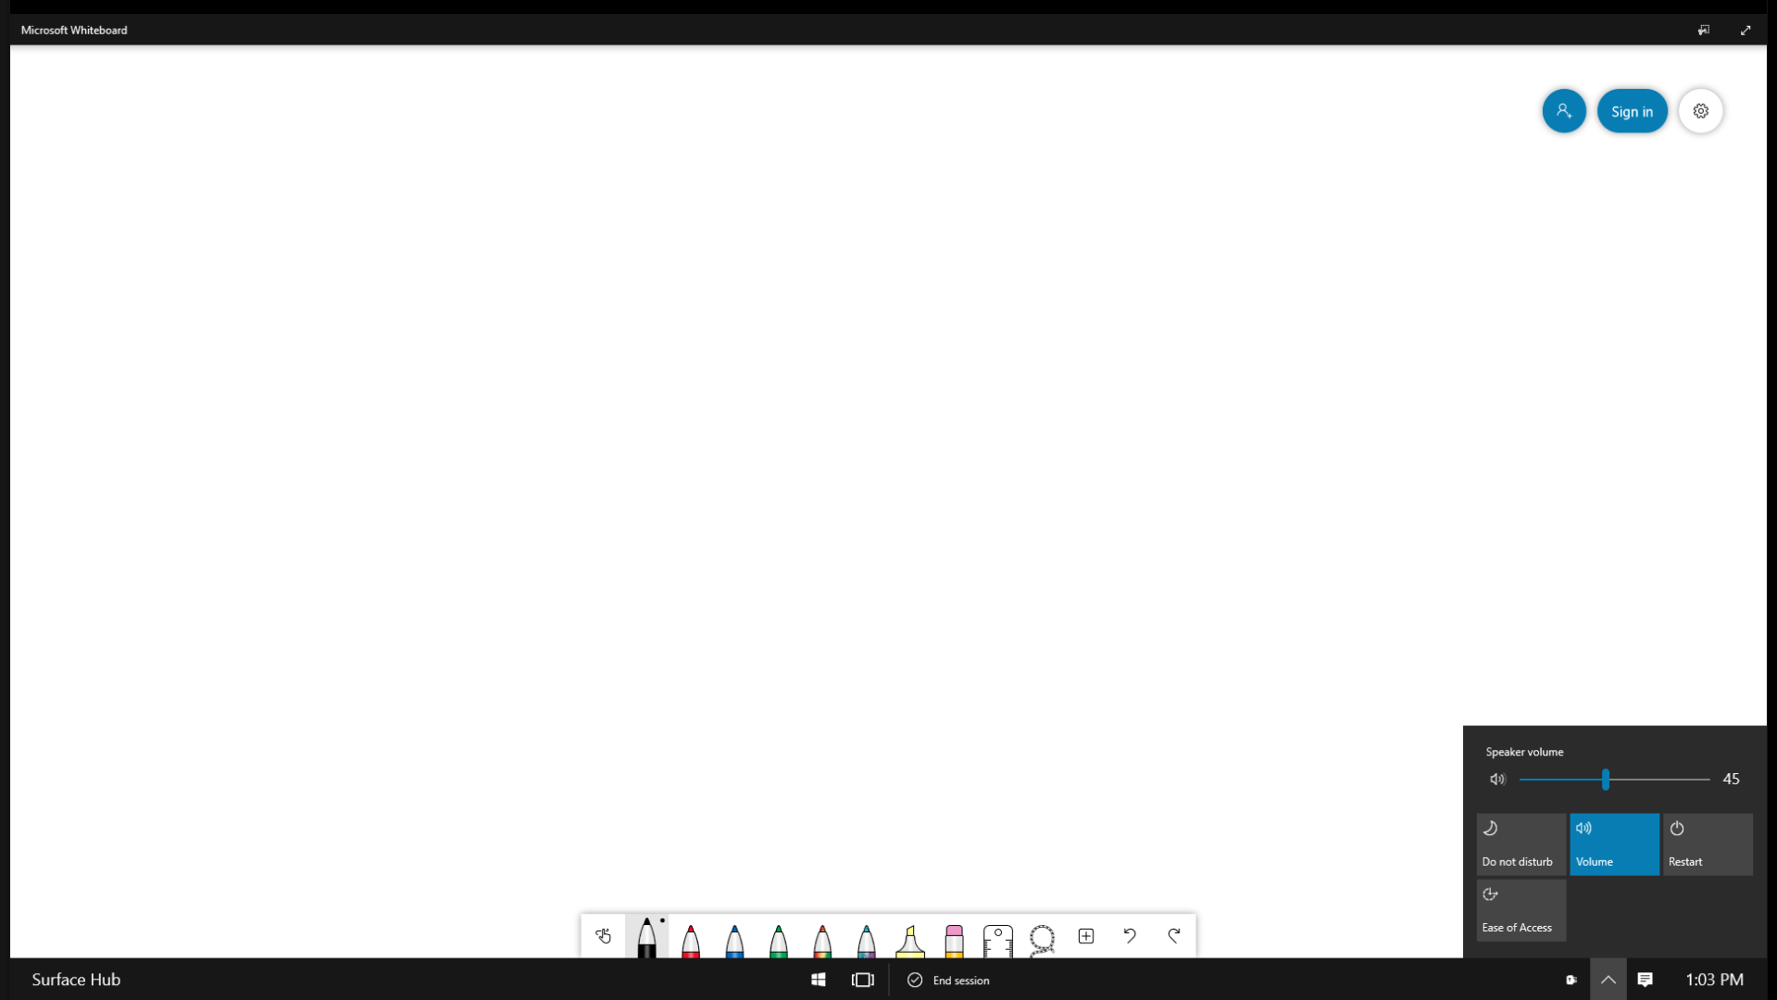
<- Back to Table of Contents

Slide 14
<- Back to Table of Contents

Slide 15
<- Back to Table of Contents

Slide 16
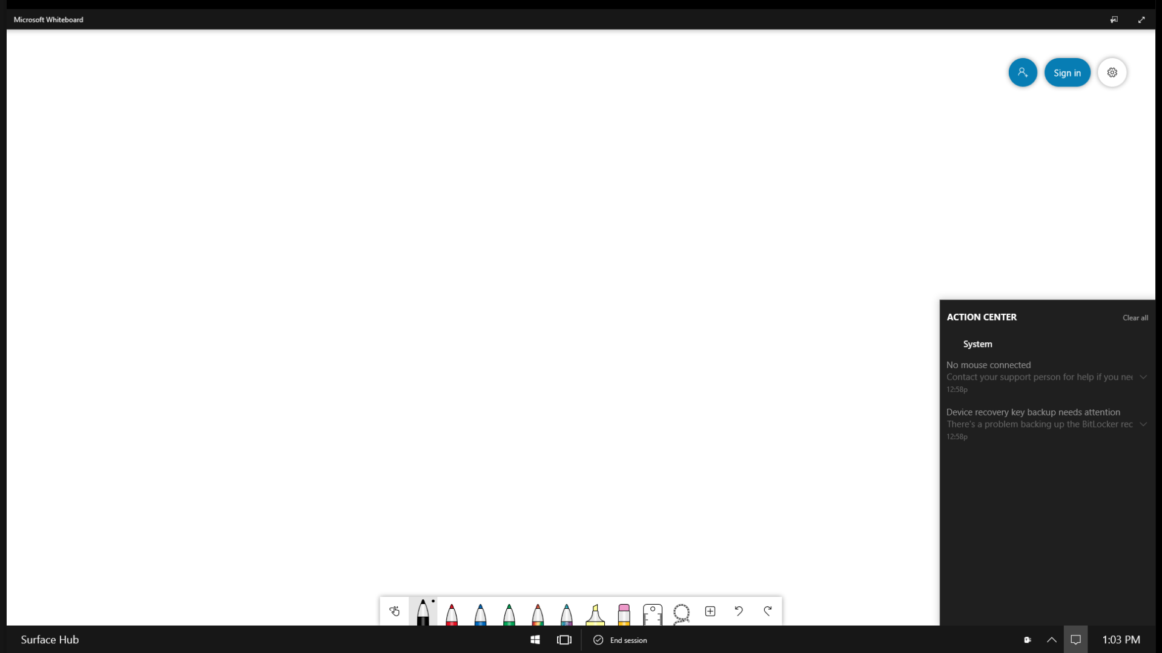
<- Back to Table of Contents

Slide 17
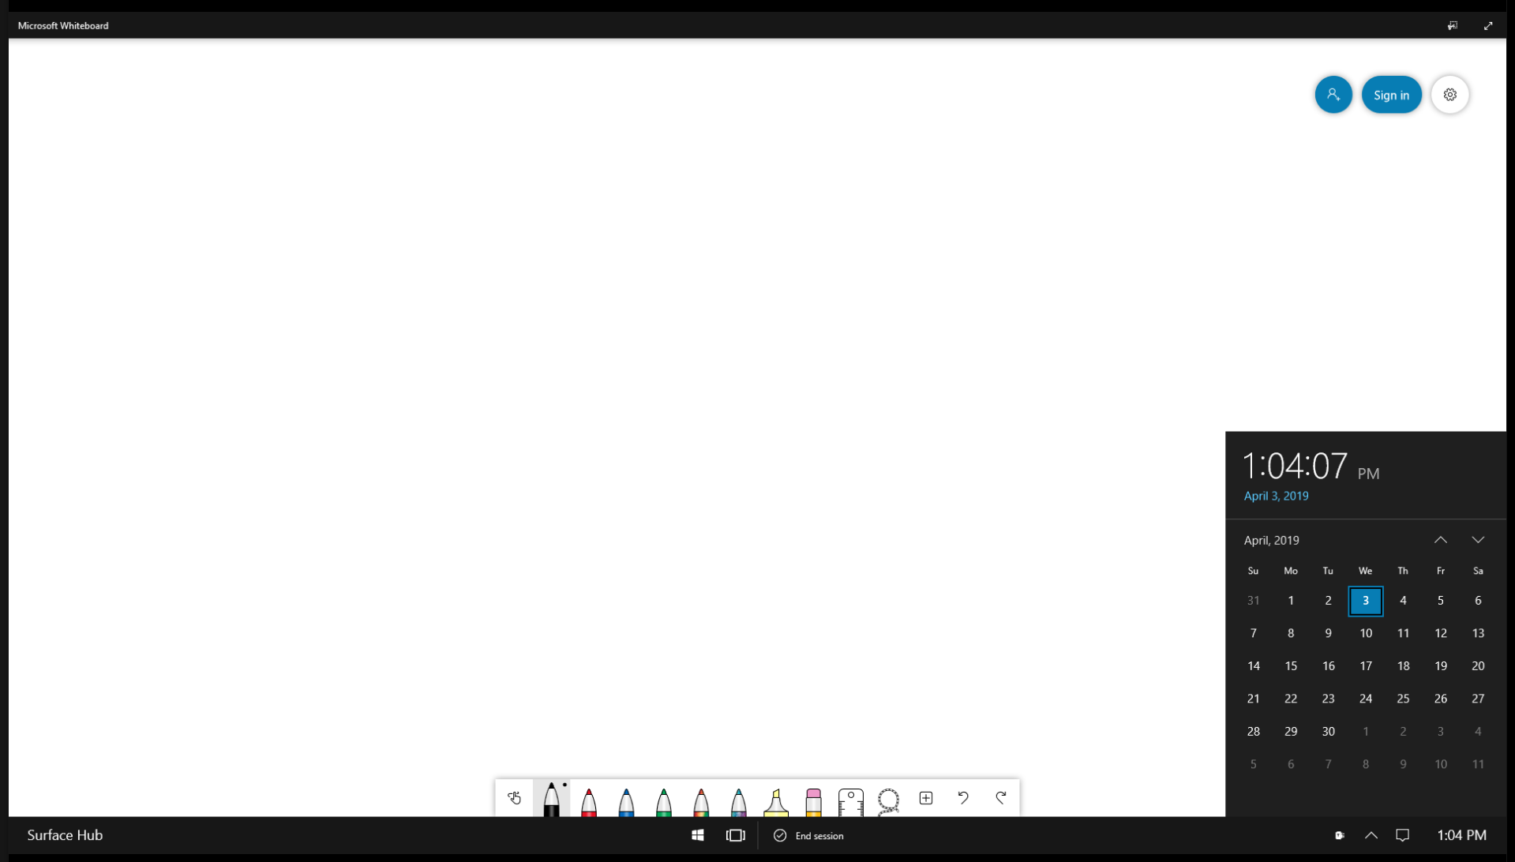
<- Back to Table of Contents

